Slide 1
ASP.NET Core 2.2
Cross-Platform Web Apps
Shahed Chowdhuri
Microsoft Corporation
@shahedC
WakeUpAndCode.com

Slide 2
Agenda
Introduction
> .NET (Framework & Core)
> ASP.NET Core
> Visual Studio & VS Code
References + Wrap-up
Notes:
Agenda

Slide 3
Introduction
Notes:
Introduction

Slide 4
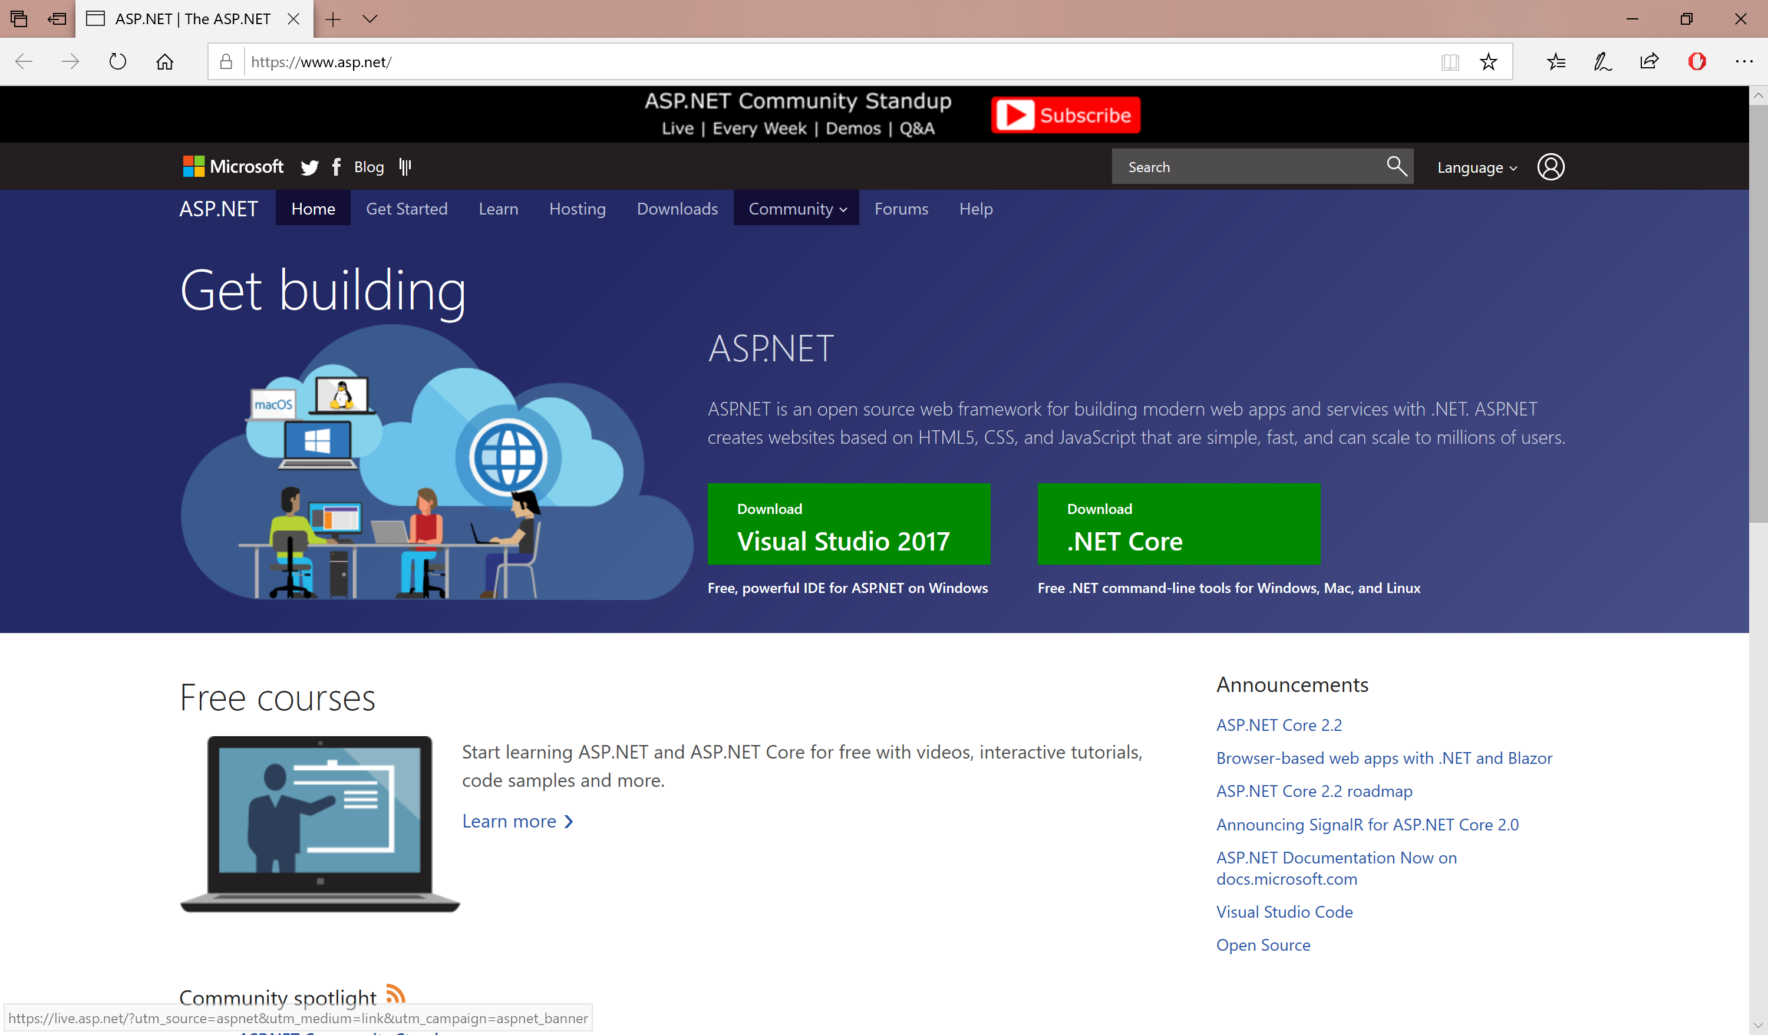
ASP.NET
Info and Downloads: http://www.asp.net/

Slide 5
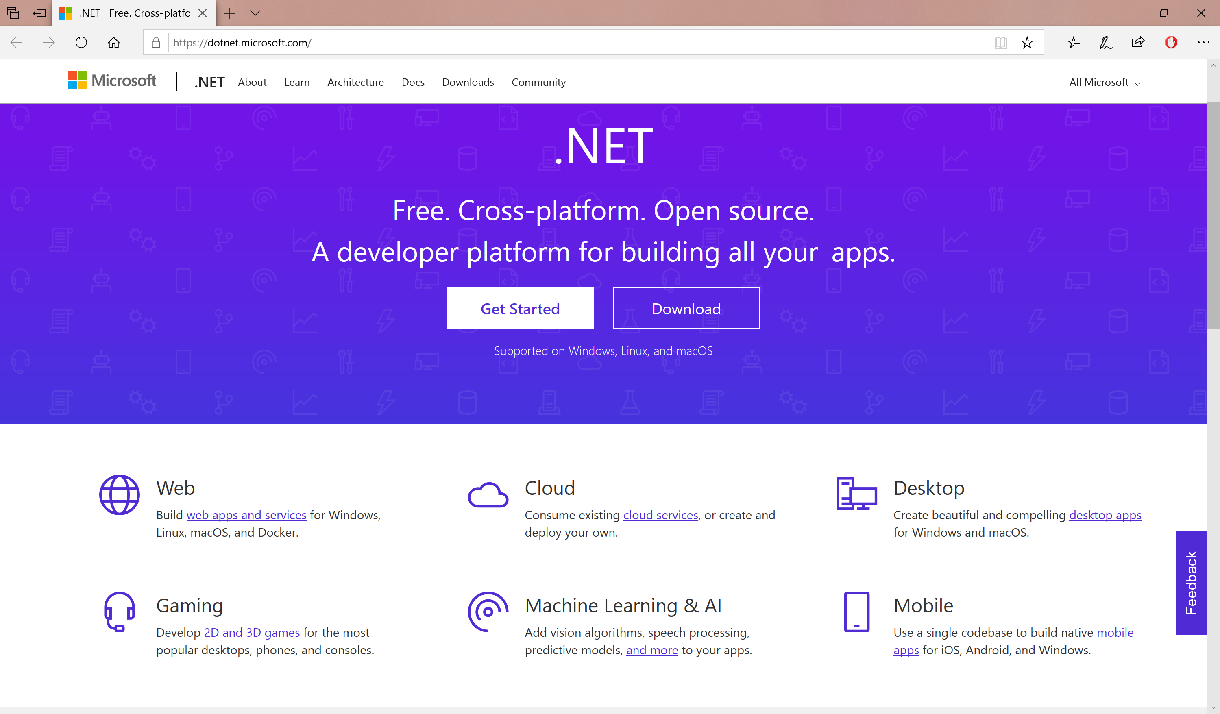
.NET for Cross-Platform Dev
.NET Info + Download: https://dotnet.microsoft.com/

Slide 6
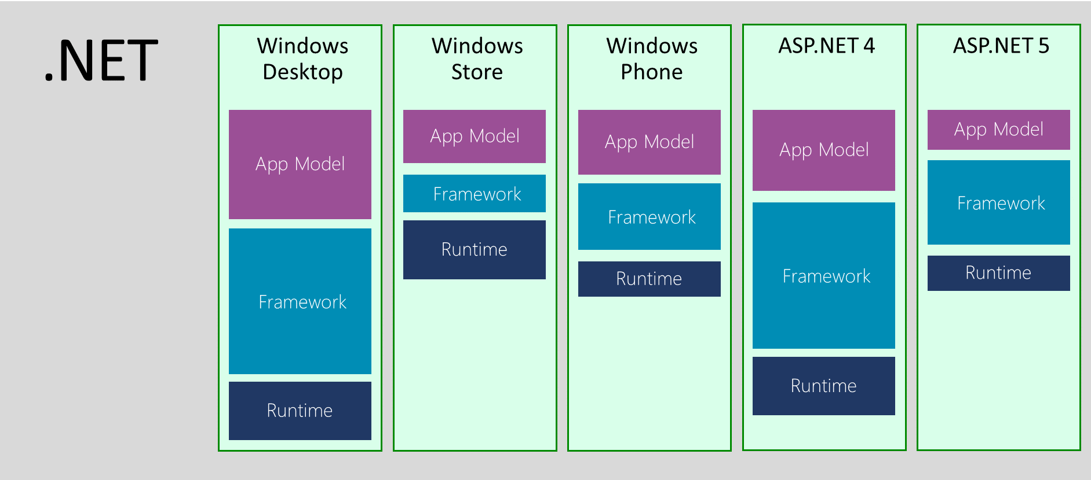
.NET Across Windows/Web Platforms
Source: http://blogs.msdn.com/b/dotnet/archive/2014/12/04/introducing-net-core.aspx

Slide 7


.NET Standard in 2017 and 2018
WINDOWS
DESKTOP
CLOUD MICROSERVICES
WINDOWS UWP
IOS, ANDROID
GAMES/ 3D
Visual Studio
.NET STANDARD
Visual Studio for Mac
INFRASTRUCTURE
COMPILERS
LANGUAGES
RUNTIME COMPONENTS
Visual Studio Code
.NET Standard allows sharing code, binaries, and skills between .NET client, server, and all flavors
.NET Standard provides a specification for any platform to implement
All .NET runtimes provided by Microsoft implement the standard

Slide 8
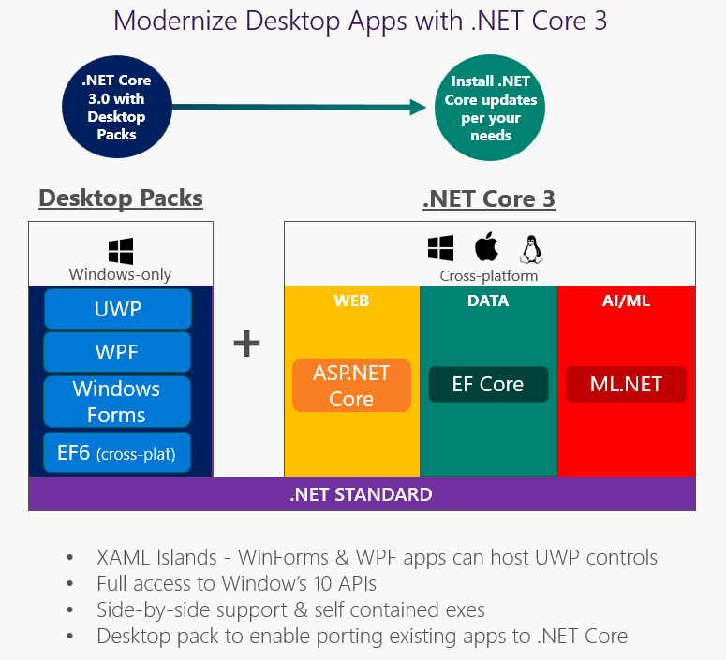
.NET 3.0 in 2019 and Beyond…
https://blogs.msdn.microsoft.com/dotnet/2018/05/07/net-core-3-and-support-for-windows-desktop-applications

Slide 9
Evolution of ASP and ASP .NET
Active Server Pages
(Classic ASP)
ASP.NET
(Web Forms)
ASP.NET
MVC
1/2/3/4/5
ASP.NET
Core MVC
Unified MVC + Web API
… and Razor Pages
ASP.NET
Web Pages
ASP.NET
Web API

Slide 10
Names & Version Numbers
C# 6.0
ASP.NET
Core MVC
C# 7.x
ASP.NET Core 2.x
(runs on .NET Core 2.x)
or .NET Framework 4.5.2+)
SignalR
.NET Framework 4.6
.NET Framework 4.7
.NET Core 2.x

Slide 11
FUTURE: Names & Version Numbers
C# 6.0
ASP.NET
Core MVC
C# 8.x
ASP.NET Core 3.x
(runs ONLY on .NET Core 3.x)
SignalR
.NET Core 3.x

Slide 12
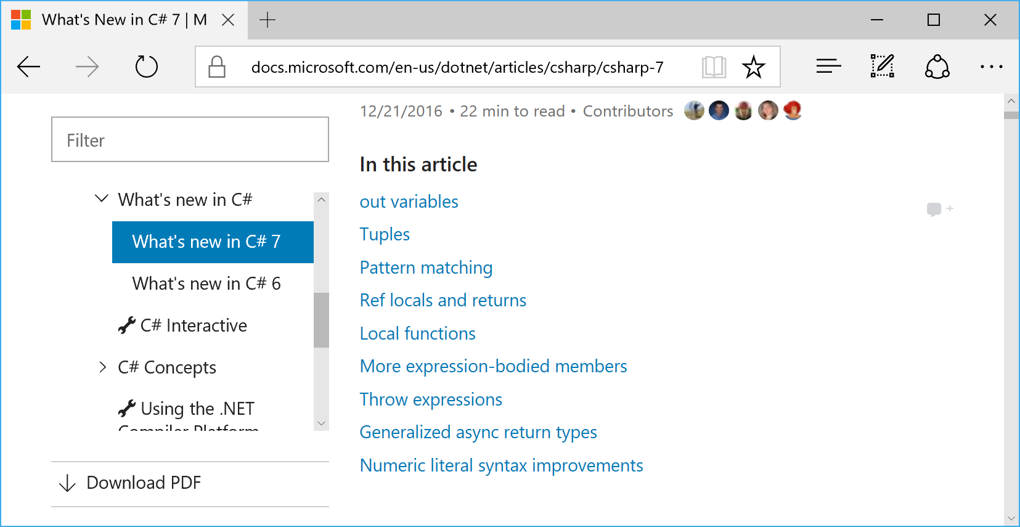
C# 7.x in VS2017
https://docs.microsoft.com/en-us/dotnet/csharp/whats-new/csharp-7-3

Slide 13
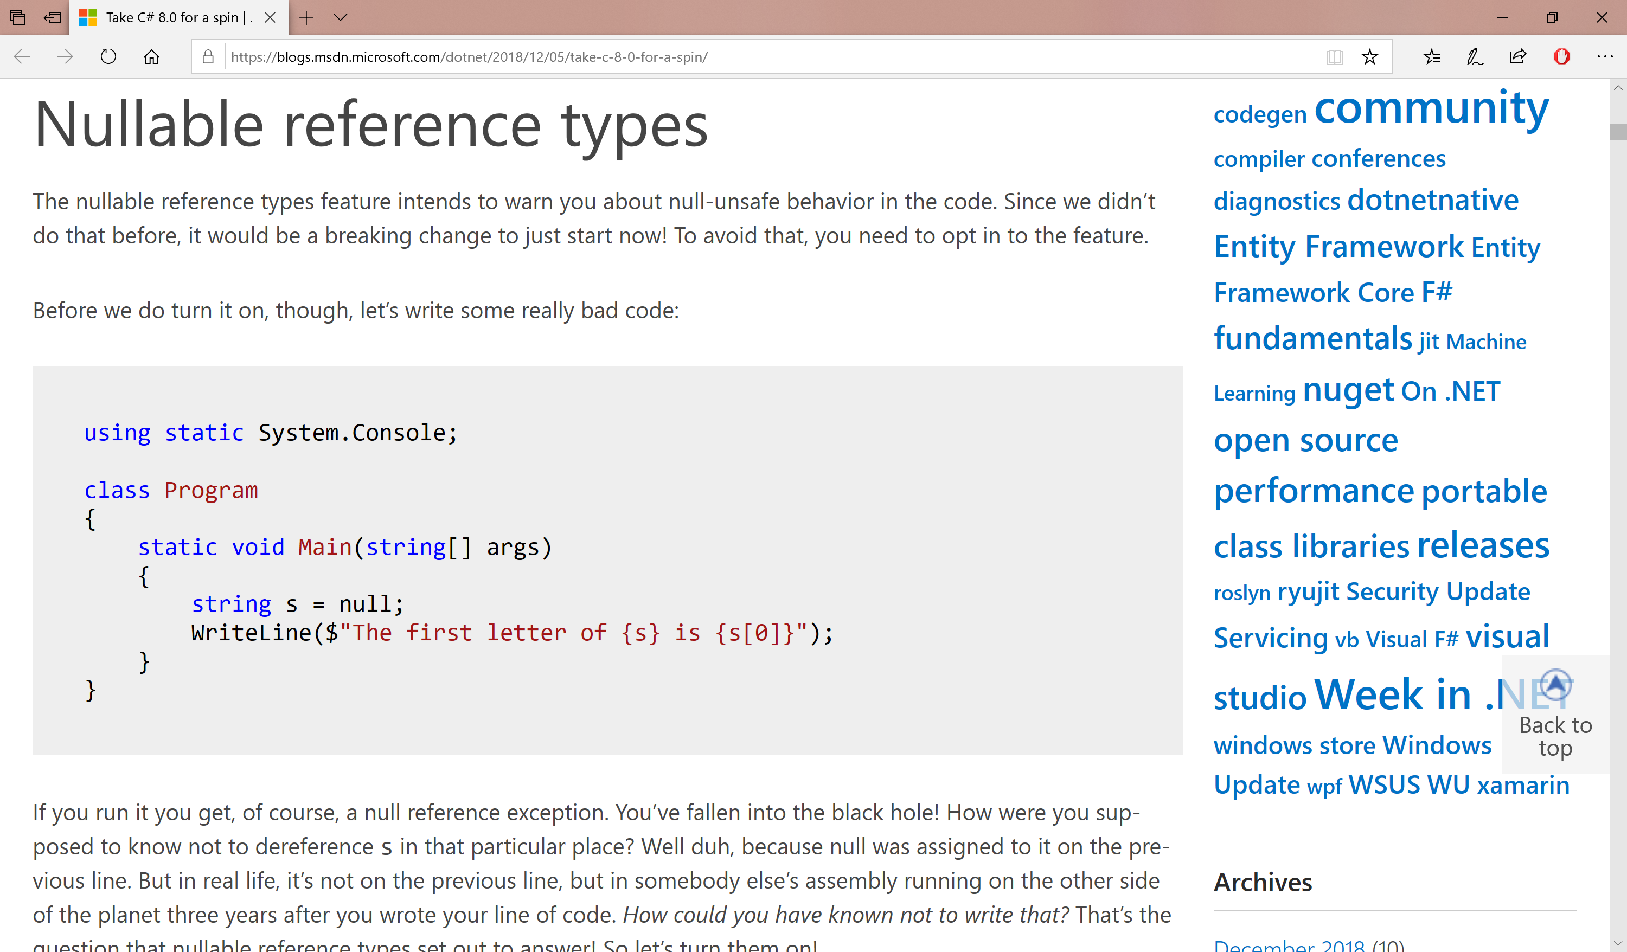
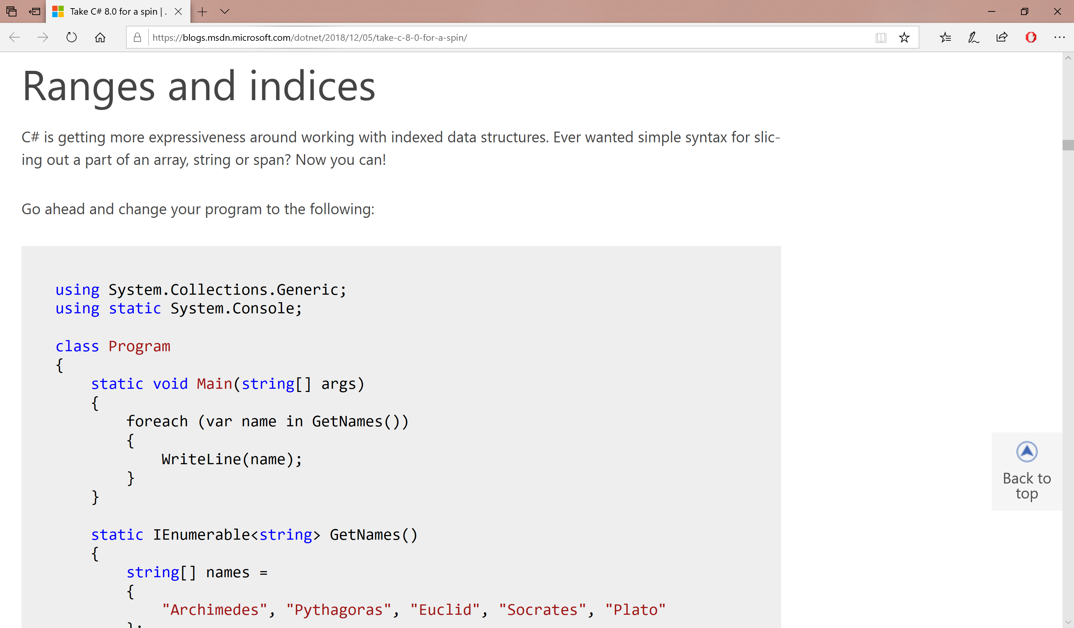
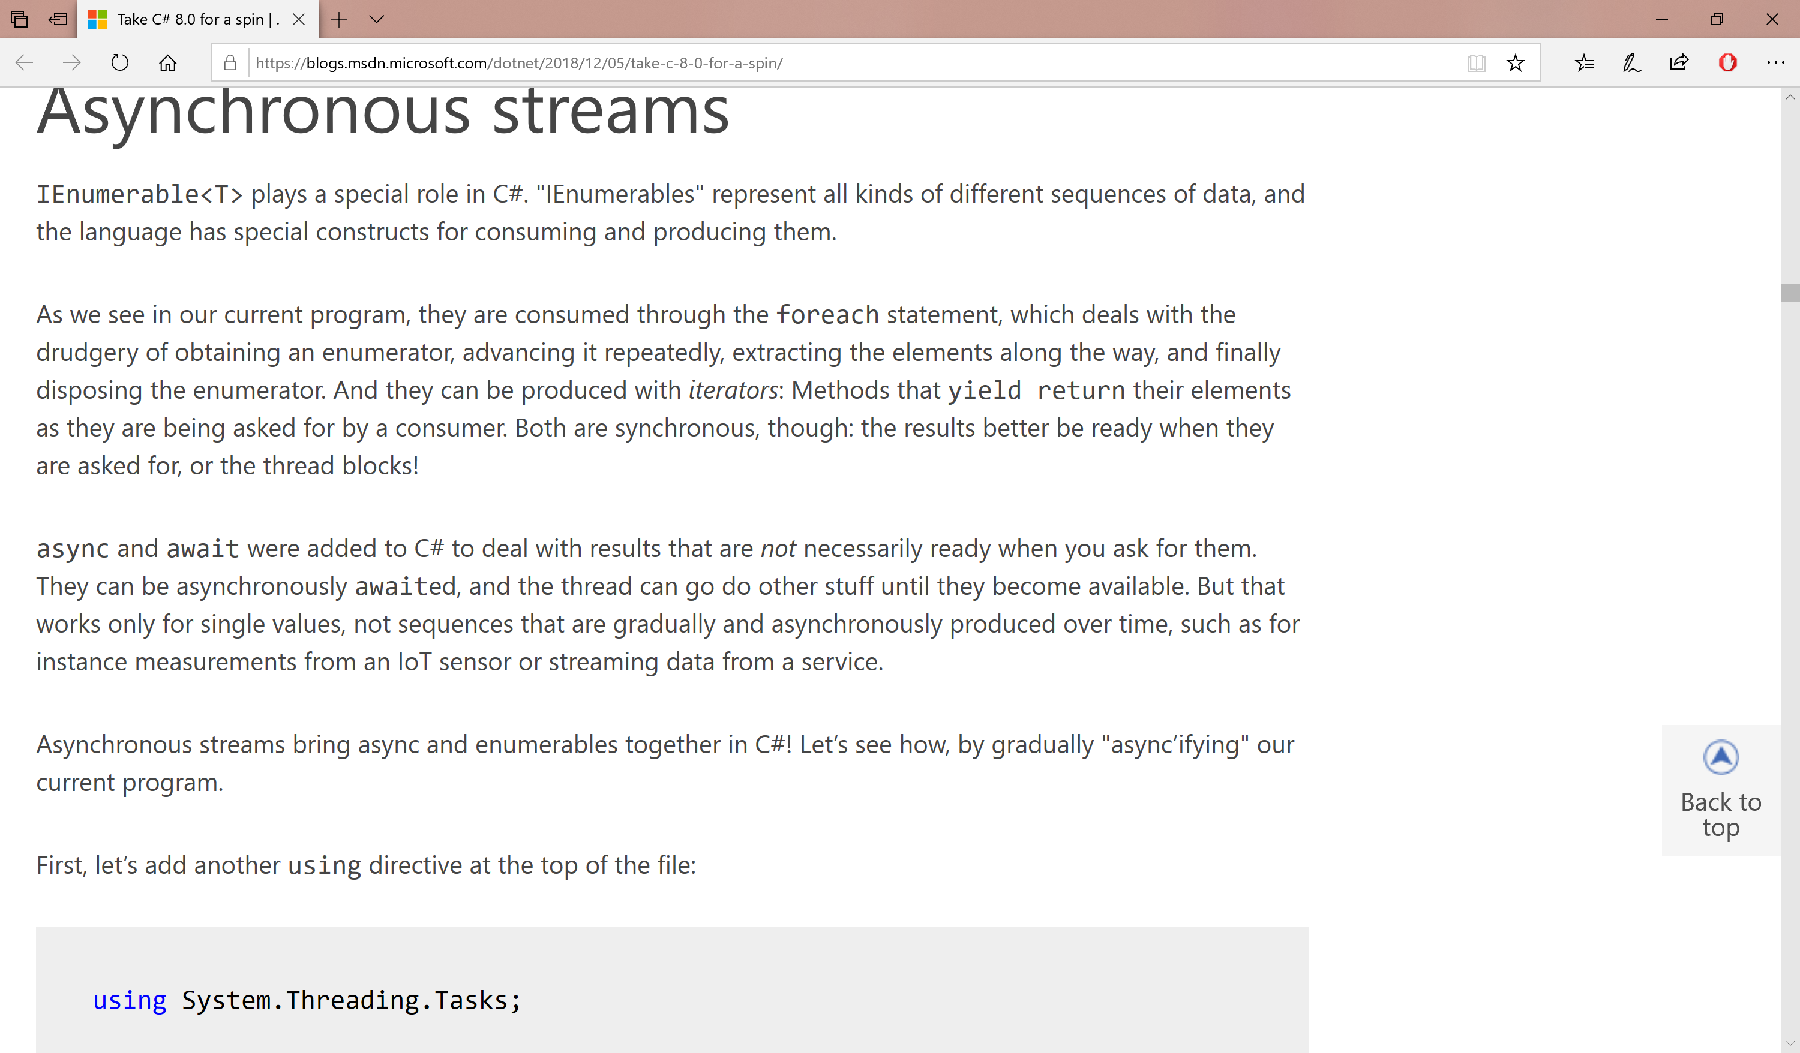
C# 8.x in VS2019
https://blogs.msdn.microsoft.com/dotnet/2018/12/05/take-c-8-0-for-a-spin/

Slide 14

Agenda
Introduction
> .NET (Framework & Core)
> ASP.NET Core
> Visual Studio & VS Code
References + Wrap-up
Notes:
Agenda

Slide 15
.NET Framework & .NET Core
Notes:
Variables, Operators & Loops

Slide 16
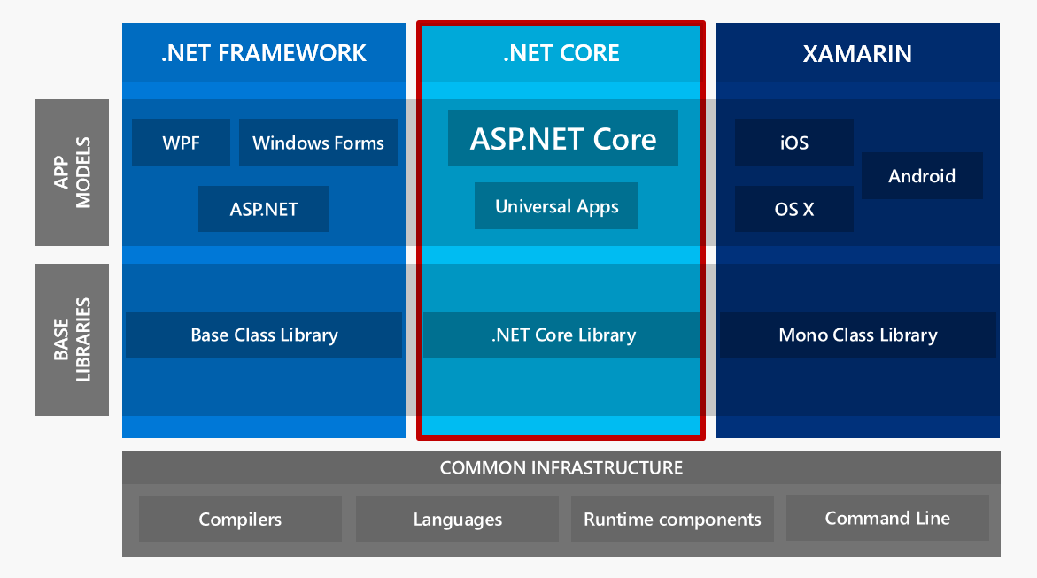
ASP.NET Core High-Level Overview

Slide 17
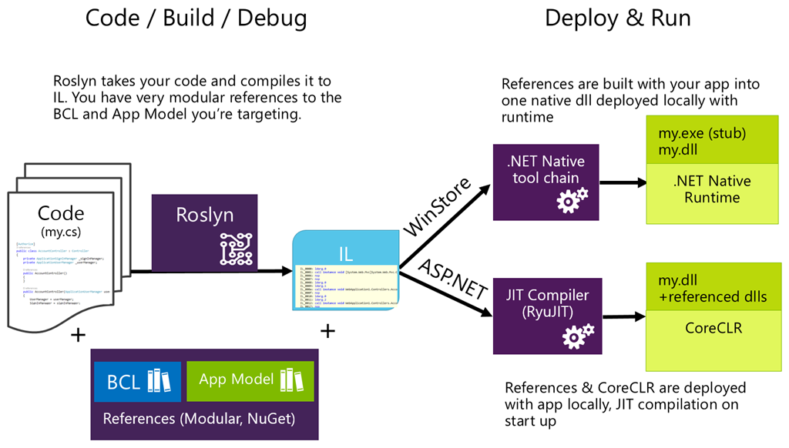
Compilation Process

Slide 18
ASP .NET Core
Notes:
ASP .NET 5.0

Slide 19
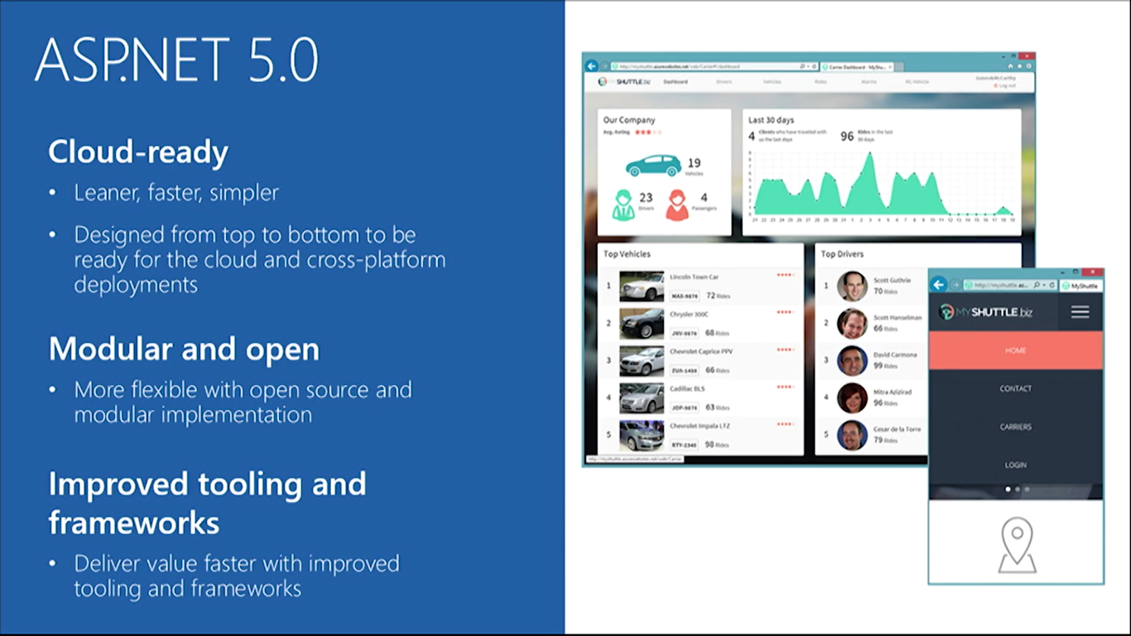

ASP.NET Core Features

Slide 20
MVC Web App Basics
Updates
View
User Requests
Controller
View
Updates
Model
Model
Gets
Data

Slide 21
MVC (Web) Controllers
public class HumanController : Controller
{
private readonly ApplicationDbContext _context;
public HumanController(ApplicationDbContext context) {}
// GET: Human, Human/Details/5
public async Task<IActionResult> Index() {}
public async Task<IActionResult> Details(int? id) {}
// GET: Human/Create
public IActionResult Create() {}
// POST: Human
[HttpPost]
[ValidateAntiForgeryToken]
public async Task<IActionResult> Create([Bind("Id,FirstName,LastName")] Human human) {}
// GET: Human/Edit/5
public async Task<IActionResult> Edit(int? id) {}
// POST: Human/Edit/5
[HttpPost]
[ValidateAntiForgeryToken]
public async Task<IActionResult> Edit(int id, [Bind("Id,FirstName,LastName")] Human human) {}
}

Slide 22
MVC (API) Controllers
public class ValuesController : Controller
{
// GET: api/Values, api/Values/5
[HttpGet]
public IEnumerable<string> Get() {}
[HttpGet("{id}", Name = "Get")]
public string Get(int id) {}
// POST: api/Values
[HttpPost]
public void Post([FromBody]string value) {}
// PUT: api/Values/5
[HttpPut("{id}")]
public void Put(int id, [FromBody]string value) {}
// DELETE: api/ApiWithActions/5
[HttpDelete("{id}")]
public void Delete(int id) {}
}

Slide 23
MVC (Web) Views
@model NiceStackWeb.Models.Human
@{
ViewData["Title"] = "Details";
}
<h2>Details</h2>
<div>
<h4>Human</h4>
<hr />
<dl class="dl-horizontal">
<dt>
@Html.DisplayNameFor(model => model.FirstName)
</dt>
<dd>
@Html.DisplayFor(model => model.FirstName)
</dd> ...
</dl>
</div>
<div>
<a asp-action="Edit" asp-route-id="@Model.Id">Edit</a> |
<a asp-action="Index">Back to List</a>
</div>

Slide 24
MVC Models
using System.ComponentModel;
using System.ComponentModel.DataAnnotations;
public class Human
{
[Key]
public int Id { get; set; }
[DisplayName("First Name")]
public string FirstName { get; set; }
[DisplayName("First Name")]
public string LastName { get; set; }
}

Slide 25
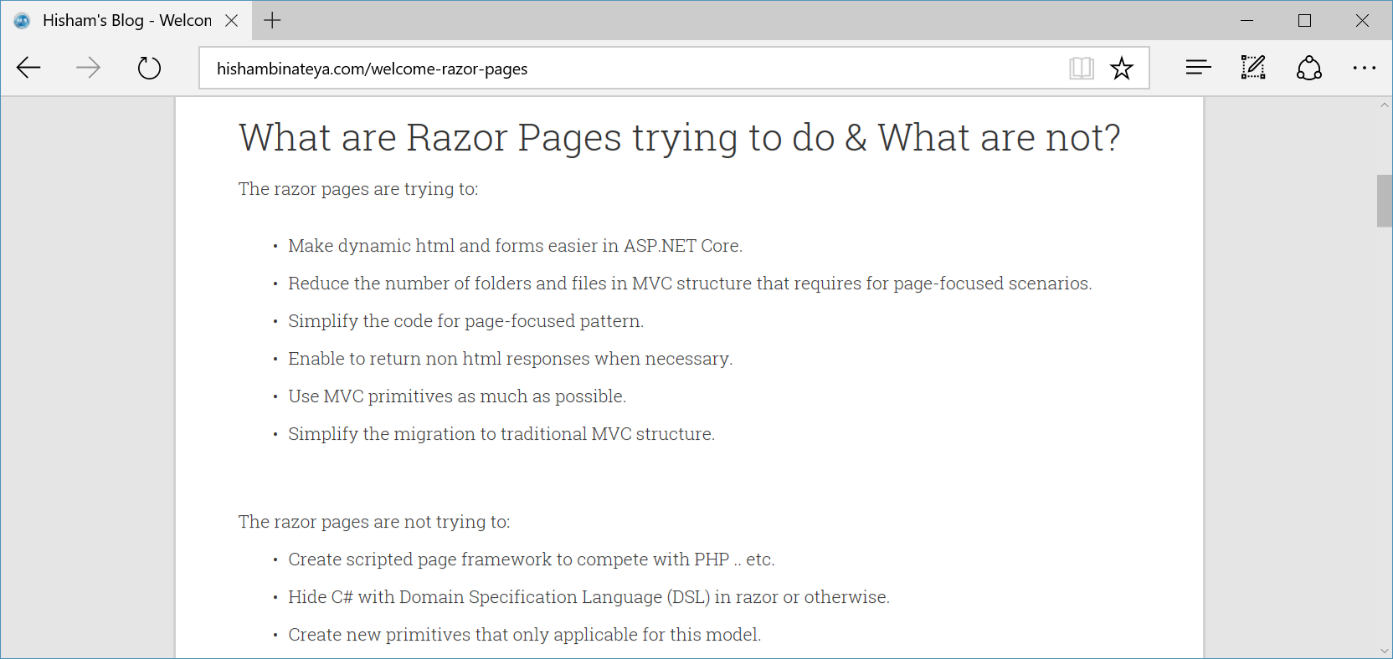
New Razor Pages!
http://www.hishambinateya.com/welcome-razor-pages

Slide 26
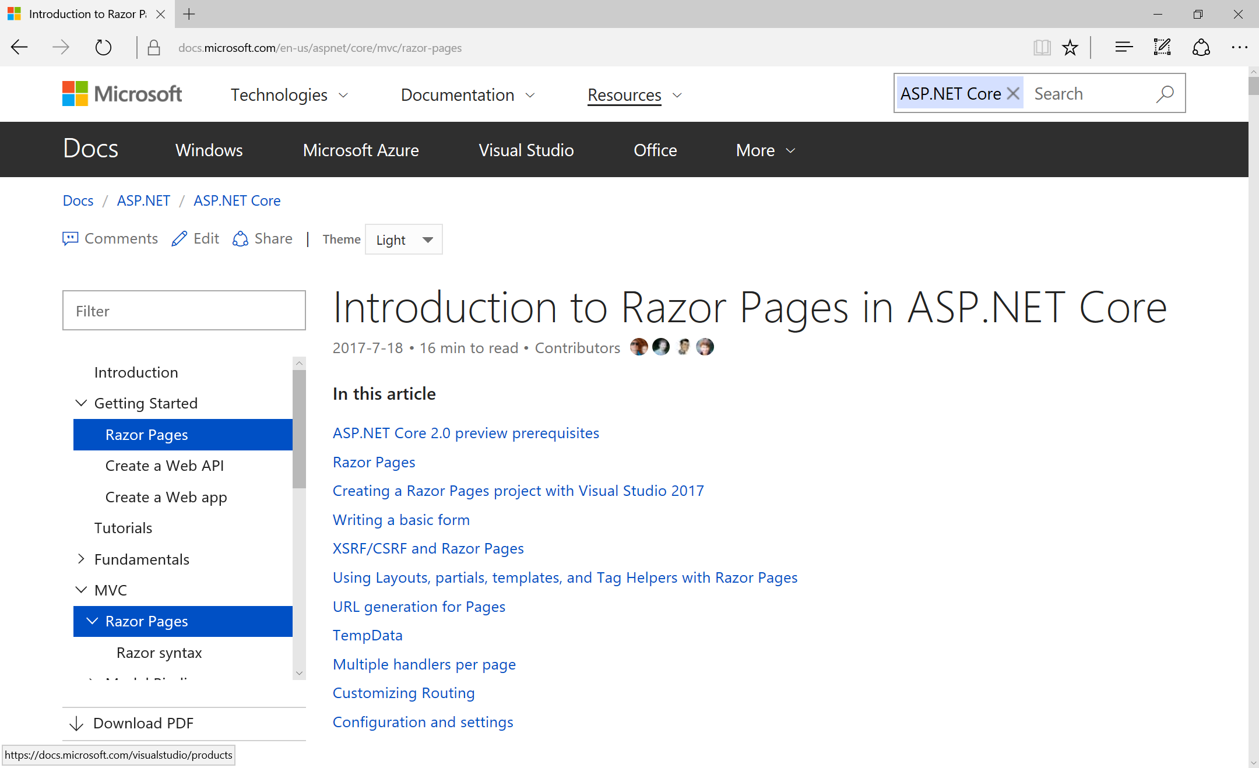
Intro to Razor Pages
https://docs.microsoft.com/en-us/aspnet/core/mvc/razor-pages

Slide 27
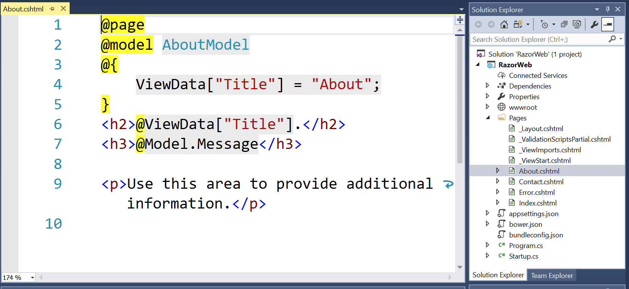
Razor Syntax

Slide 28
UI Options
Razor markup file (.cshtml) that renders HTML output within another markup file's rendered output
when complex rendering logic or code execution is required to render the markup
Partial views
View components
Tag helpers
Razor Class Libraries
NuGet packages
Razor views, pages, controllers, page models, View components, data models can be built into a Razor Class Library (RCL).
enable server-side code to participate in creating and rendering HTML elements in Razor files.

Slide 29
SignalR in ASP.NET Core 2.1 (Stable!)
using Microsoft.AspNetCore.SignalR;
namespace SignalRTutorial.Hubs
{
[Authorize]
public class ChatHub : Hub
{
public override async Task OnConnectedAsync()
{
await Clients.All.SendAsync("SendAction", Context.User.Identity.Name, "joined");
}
public override async Task OnDisconnectedAsync(Exception ex)
{
await Clients.All.SendAsync("SendAction", Context.User.Identity.Name, "left");
}
public async Task Send(string message)
{
await Clients.All.SendAsync("SendMessage", Context.User.Identity.Name, message);
}
}
}
https://blogs.msdn.microsoft.com/webdev/2018/02/27/asp-net-core-2-1-0-preview1-getting-started-with-signalr

Slide 30
What’s New in 2.1?
Notes:
ASP .NET 5.0

Slide 31
ASP.NET Core 2.1: What’s New?
SignalR
HSTS Protocol
&
HTTPS by default
New Web API conventions
Swagger support
ActionResult<T>
HTTP Client Factory
ANCM in-process mode for IIS performance
ASP.NET Identity as UI Library
GDPR Compliance
Build-time Razor Compilation
New Razor SDK
Virtual Auth Schemes
MVC Functional Test Fixture
http://www.talkingdotnet.com/quick-summary-whats-new-asp-net-core-2-1/

Slide 32
ASP.NET Core 2.1: What’s New?
SignalR
HSTS Protocol
&
HTTPS by default
New Web API conventions
Swagger support
Real-time web development
New Typescript client, jQuery
Built-in Hub protocols:
JSON-based for text
MessagePack for binary
Improved scale-out model
Sticky sessions required*
*required when using WebSockets unless skipNegotiation flag is set to true
var connection = new signalR.HubConnectionBuilder().withUrl("/chat",
{
skipNegotiation: true,
transport: signalR.HttpTransportType.WebSockets
})
.build();
ActionResult<T>
HTTP Client Factory
ANCM in-process mode for IIS performance
ASP.NET Identity as UI Library
GDPR Compliance
Build-time Razor Compilation
New Razor SDK
Virtual Auth Schemes
MVC Functional Test Fixture
http://www.talkingdotnet.com/quick-summary-whats-new-asp-net-core-2-1/

Slide 33
ASP.NET Core 2.1: What’s New?
SignalR
HSTS Protocol
&
HTTPS by default
New Web API conventions
Swagger support
UseHttpsRedirection by default
HSTS protocol support (non-dev)
>dotnet dev-certs https --trust
ActionResult<T>
HTTP Client Factory
ANCM in-process mode for IIS performance
ASP.NET Identity as UI Library
GDPR Compliance
Build-time Razor Compilation
New Razor SDK
Virtual Auth Schemes
MVC Functional Test Fixture
http://www.talkingdotnet.com/quick-summary-whats-new-asp-net-core-2-1/

Slide 34
ASP.NET Core 2.1: What’s New?
SignalR
HSTS Protocol
&
HTTPS by default
New Web API conventions
Swagger support
New ApiController attribute
Auto model validation
ActionResult<T>
HTTP Client Factory
ANCM in-process mode for IIS performance
ASP.NET Identity as UI Library
GDPR Compliance
Build-time Razor Compilation
New Razor SDK
Virtual Auth Schemes
MVC Functional Test Fixture
http://www.talkingdotnet.com/quick-summary-whats-new-asp-net-core-2-1/

Slide 35
ASP.NET Core 2.1: What’s New?
SignalR
HSTS Protocol
&
HTTPS by default
New Web API conventions
Swagger support
Rich Swagger support
Easier API documentation
ActionResult<T>
HTTP Client Factory
ANCM in-process mode for IIS performance
ASP.NET Identity as UI Library
GDPR Compliance
Build-time Razor Compilation
New Razor SDK
Virtual Auth Schemes
MVC Functional Test Fixture
http://www.talkingdotnet.com/quick-summary-whats-new-asp-net-core-2-1/

Slide 36
ASP.NET Core 2.1: What’s New?
SignalR
HSTS Protocol
&
HTTPS by default
New Web API conventions
Swagger support
ActionResult<T>
HTTP Client Factory
ANCM in-process mode for IIS performance
New type ActionResult<T>
Indicate response type for any action result
ASP.NET Identity as UI Library
GDPR Compliance
Build-time Razor Compilation
New Razor SDK
Virtual Auth Schemes
MVC Functional Test Fixture
http://www.talkingdotnet.com/quick-summary-whats-new-asp-net-core-2-1/

Slide 37
ASP.NET Core 2.1: What’s New?
SignalR
HSTS Protocol
&
HTTPS by default
New Web API conventions
Swagger support
ActionResult<T>
HTTP Client Factory
ANCM in-process mode for IIS performance
HttpClient as a service
Register, configure, consume HttpClient instances
ASP.NET Identity as UI Library
GDPR Compliance
Build-time Razor Compilation
New Razor SDK
Virtual Auth Schemes
MVC Functional Test Fixture
http://www.talkingdotnet.com/quick-summary-whats-new-asp-net-core-2-1/

Slide 38
ASP.NET Core 2.1: What’s New?
SignalR
HSTS Protocol
&
HTTPS by default
New Web API conventions
Swagger support
ActionResult<T>
HTTP Client Factory
ANCM in-process mode for IIS performance
ASP.NET Core (native IIS) Module
Hooks into IIS pipeline
Improved Performance
ASP.NET Identity as UI Library
GDPR Compliance
Build-time Razor Compilation
New Razor SDK
Virtual Auth Schemes
MVC Functional Test Fixture
http://www.talkingdotnet.com/quick-summary-whats-new-asp-net-core-2-1/

Slide 39
ASP.NET Core 2.1: What’s New?
SignalR
HSTS Protocol
&
HTTPS by default
New Web API conventions
Swagger support
ActionResult<T>
HTTP Client Factory
ANCM in-process mode for IIS performance
Default UI implemented in a library
Available as NuGet package
Enable via Startup class
ASP.NET Identity as UI Library
GDPR Compliance
Build-time Razor Compilation
New Razor SDK
Virtual Auth Schemes
MVC Functional Test Fixture
http://www.talkingdotnet.com/quick-summary-whats-new-asp-net-core-2-1/

Slide 40
ASP.NET Core 2.1: What’s New?
SignalR
HSTS Protocol
&
HTTPS by default
New Web API conventions
Swagger support
ActionResult<T>
HTTP Client Factory
ANCM in-process mode for IIS performance
Compliance for EU General Data Protection Regulation reqts
Request user consent for info
ASP.NET Identity as UI Library
GDPR Compliance
Build-time Razor Compilation
New Razor SDK
Virtual Auth Schemes
MVC Functional Test Fixture
http://www.talkingdotnet.com/quick-summary-whats-new-asp-net-core-2-1/

Slide 41
ASP.NET Core 2.1: What’s New?
SignalR
HSTS Protocol
&
HTTPS by default
New Web API conventions
Swagger support
ActionResult<T>
HTTP Client Factory
ANCM in-process mode for IIS performance
Mix authentication schemes
e.g. Bearer tokens, cookie auth
ASP.NET Identity as UI Library
GDPR Compliance
Build-time Razor Compilation
New Razor SDK
Virtual Auth Schemes
MVC Functional Test Fixture
http://www.talkingdotnet.com/quick-summary-whats-new-asp-net-core-2-1/

Slide 42
ASP.NET Core 2.1: What’s New?
SignalR
HSTS Protocol
&
HTTPS by default
New Web API conventions
Swagger support
ActionResult<T>
HTTP Client Factory
ANCM in-process mode for IIS performance
Compiled during build process
Improved startup performance
ASP.NET Identity as UI Library
GDPR Compliance
Build-time Razor Compilation
New Razor SDK
Virtual Auth Schemes
MVC Functional Test Fixture
http://www.talkingdotnet.com/quick-summary-whats-new-asp-net-core-2-1/

Slide 43
ASP.NET Core 2.1: What’s New?
SignalR
HSTS Protocol
&
HTTPS by default
New Web API conventions
Swagger support
ActionResult<T>
HTTP Client Factory
ANCM in-process mode for IIS performance
Razor UI as class library
Share across projects
Share as Nuget package
ASP.NET Identity as UI Library
GDPR Compliance
Build-time Razor Compilation
New Razor SDK
Virtual Auth Schemes
MVC Functional Test Fixture
http://www.talkingdotnet.com/quick-summary-whats-new-asp-net-core-2-1/

Slide 44
ASP.NET Core 2.1: What’s New?
SignalR
HSTS Protocol
&
HTTPS by default
New Web API conventions
Swagger support
ActionResult<T>
HTTP Client Factory
ANCM in-process mode for IIS performance
Improved end-to-end testing
e.g. routing, filters, controllers, actions, views and pages
ASP.NET Identity as UI Library
GDPR Compliance
Build-time Razor Compilation
New Razor SDK
Virtual Auth Schemes
MVC Functional Test Fixture
http://www.talkingdotnet.com/quick-summary-whats-new-asp-net-core-2-1/

Slide 45
What’s New in 2.2?
Notes:
ASP .NET 5.0

Slide 46
ASP.NET Core 2.2: What’s New?
Open API Analyzers & Conventions
Problem details support
Endpoint Routing
Health checks
HTTP/2 in Kestrel
Kestrel configuration
IIS in-process hosting
SignalR
Java
client
CORS improvements
Project templates
Validation performance
Response compression
HTTP Client performance
https://docs.microsoft.com/en-us/aspnet/core/release-notes/aspnetcore-2.2

Slide 47
ASP.NET Core 2.2: What’s New?
Open API Analyzers & Conventions
Problem details support
Endpoint Routing
Health checks
Improved Open API (Swagger) support
Use DefaultApiConventions
Define HTTP responses
HTTP/2 in Kestrel
Kestrel configuration
IIS in-process hosting
SignalR
Java
client
CORS improvements
Project templates
Validation performance
Response compression
HTTP Client performance
https://docs.microsoft.com/en-us/aspnet/core/release-notes/aspnetcore-2.2

Slide 48
ASP.NET Core 2.2: What’s New?
Open API Analyzers & Conventions
Problem details support
Endpoint Routing
Health checks
Improved ProblemDetails support
Return ProblemDetails for 4xx errors
Used with [ApiController] attribute
HTTP/2 in Kestrel
Kestrel configuration
IIS in-process hosting
SignalR
Java
client
CORS improvements
Project templates
Validation performance
Response compression
HTTP Client performance
https://docs.microsoft.com/en-us/aspnet/core/release-notes/aspnetcore-2.2

Slide 49
ASP.NET Core 2.2: What’s New?
Open API Analyzers & Conventions
Problem details support
Endpoint Routing
Health checks
Improved request dispatch
New link generation API members
Route parameter transformers
Performance Improvements
HTTP/2 in Kestrel
Kestrel configuration
IIS in-process hosting
SignalR
Java
client
CORS improvements
Project templates
Validation performance
Response compression
HTTP Client performance
https://docs.microsoft.com/en-us/aspnet/core/release-notes/aspnetcore-2.2

Slide 50
ASP.NET Core 2.2: What’s New?
Open API Analyzers & Conventions
Problem details support
Endpoint Routing
Health checks
Middleware for health checks
Used by container orchestrator
Used by load balancer
Used by real-time monitoring service
Verify if system is responding normally
HTTP/2 in Kestrel
Kestrel configuration
IIS in-process hosting
SignalR
Java
client
CORS improvements
Project templates
Validation performance
Response compression
HTTP Client performance
https://docs.microsoft.com/en-us/aspnet/core/release-notes/aspnetcore-2.2

Slide 51
ASP.NET Core 2.2: What’s New?
Open API Analyzers & Conventions
Problem details support
Endpoint Routing
Health checks
New support for HTTP/2
Header Compression
Fully Multiplexed Streams
HTTP/2 in Kestrel
Kestrel configuration
IIS in-process hosting
SignalR
Java
client
CORS improvements
Project templates
Validation performance
Response compression
HTTP Client performance
https://docs.microsoft.com/en-us/aspnet/core/release-notes/aspnetcore-2.2

Slide 52
ASP.NET Core 2.2: What’s New?
Open API Analyzers & Conventions
Problem details support
Endpoint Routing
Health checks
HTTP/2 in Kestrel
Kestrel configuration
IIS in-process hosting
Improved Kestrel configuration
ConfigureKestrel on Host Builder
Resolves in-process hosting issues
SignalR
Java
client
CORS improvements
Project templates
Validation performance
Response compression
HTTP Client performance
https://docs.microsoft.com/en-us/aspnet/core/release-notes/aspnetcore-2.2

Slide 53
ASP.NET Core 2.2: What’s New?
Open API Analyzers & Conventions
Problem details support
Endpoint Routing
Health checks
HTTP/2 in Kestrel
Kestrel configuration
IIS in-process hosting
App hosted inside IIS worker process
ASP .NET Core Module boots CoreCLR
Perf + diagnostic gains with IIS use
SignalR
Java
client
CORS improvements
Project templates
Validation performance
Response compression
HTTP Client performance
https://docs.microsoft.com/en-us/aspnet/core/release-notes/aspnetcore-2.2

Slide 54
ASP.NET Core 2.2: What’s New?
Open API Analyzers & Conventions
Problem details support
Endpoint Routing
Health checks
HTTP/2 in Kestrel
Kestrel configuration
IIS in-process hosting
New Java client for SignalR
Connect from Java code
Includes Android app support
Validation performance
SignalR
Java
client
CORS improvements
Project templates
Response compression
HTTP Client performance
https://docs.microsoft.com/en-us/aspnet/core/release-notes/aspnetcore-2.2

Slide 55
ASP.NET Core 2.2: What’s New?
Open API Analyzers & Conventions
Problem details support
Endpoint Routing
Health checks
HTTP/2 in Kestrel
Kestrel configuration
IIS in-process hosting
New CORS Middleware policy enforces sent headers
Headers sent in Access-Control-Request-Headers
Match compared with headers stated in WithHeaders
SignalR
Java
client
CORS improvements
Project templates
Validation performance
Response compression
HTTP Client performance
https://docs.microsoft.com/en-us/aspnet/core/release-notes/aspnetcore-2.2

Slide 56
ASP.NET Core 2.2: What’s New?
Open API Analyzers & Conventions
Problem details support
Endpoint Routing
Health checks
HTTP/2 in Kestrel
Kestrel configuration
IIS in-process hosting
Middleware support for “Brotli” compression data format
Used for response compression
Lossless + Efficient
SignalR
Java
client
CORS improvements
Project templates
Validation performance
Response compression
HTTP Client performance
https://docs.microsoft.com/en-us/aspnet/core/release-notes/aspnetcore-2.2

Slide 57
ASP.NET Core 2.2: What’s New?
Open API Analyzers & Conventions
Problem details support
Endpoint Routing
Health checks
HTTP/2 in Kestrel
Kestrel configuration
IIS in-process hosting
New 2.2 Templates
Bootstrap 4
Angular 6 (for now)
Simpler UI
SignalR
Java
client
CORS improvements
Project templates
Validation performance
Response compression
HTTP Client performance
https://docs.microsoft.com/en-us/aspnet/core/release-notes/aspnetcore-2.2

Slide 58
ASP.NET Core 2.2: What’s New?
Open API Analyzers & Conventions
Problem details support
Endpoint Routing
Health checks
HTTP/2 in Kestrel
Kestrel configuration
IIS in-process hosting
MVC Validation Improvements
Skips validation if possible
SignalR
Java
client
CORS improvements
Project templates
Validation performance
Response compression
HTTP Client performance
https://docs.microsoft.com/en-us/aspnet/core/release-notes/aspnetcore-2.2

Slide 59
ASP.NET Core 2.2: What’s New?
Open API Analyzers & Conventions
Problem details support
Endpoint Routing
Health checks
HTTP/2 in Kestrel
Kestrel configuration
IIS in-process hosting
SocketsHttpHandler perf improved
Outoing HTTP requests improvements
HttpClient throughout improved under load, both Linux + Windows servers
SignalR
Java
client
CORS improvements
Project templates
Validation performance
Response compression
HTTP Client performance
https://docs.microsoft.com/en-us/aspnet/core/release-notes/aspnetcore-2.2

Slide 60
ASP.NET Core 2.2: What’s New?
Open API Analyzers & Conventions
Problem details support
Endpoint Routing
Health checks
HTTP/2 in Kestrel
Kestrel configuration
IIS in-process hosting
SignalR
Java
client
CORS improvements
Project templates
Validation performance
Response compression
HTTP Client performance
https://docs.microsoft.com/en-us/aspnet/core/release-notes/aspnetcore-2.2

Slide 61
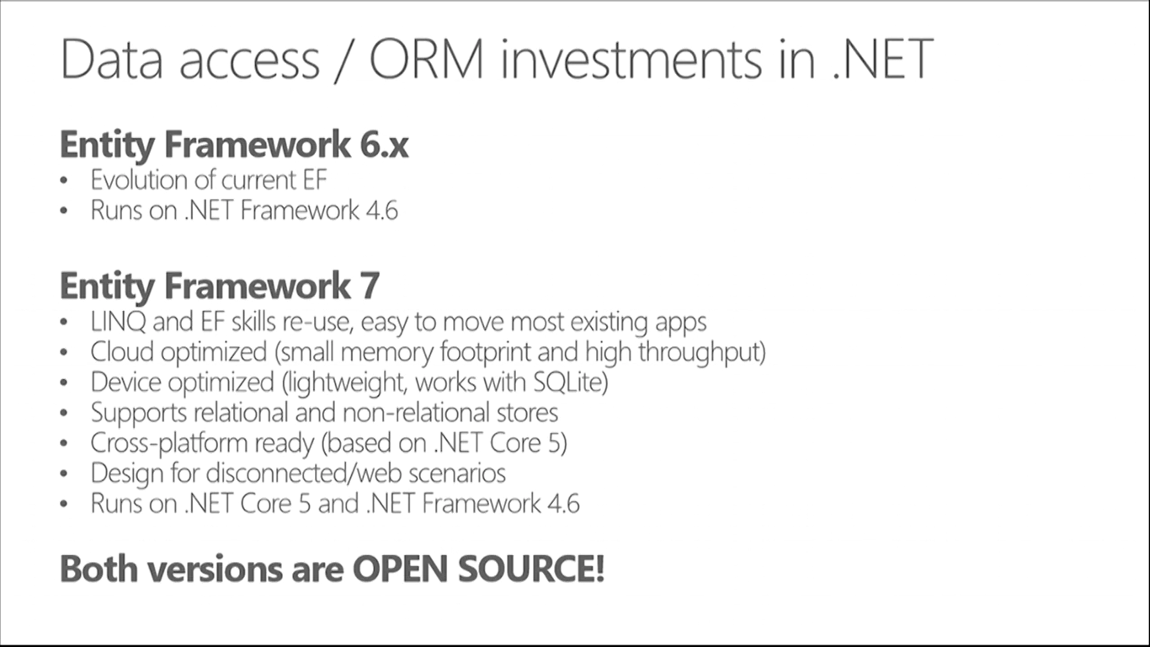
How about Entity Framework?
Entities in Code
4.6+
Core
ORM
)
4.6+
DB

Slide 62
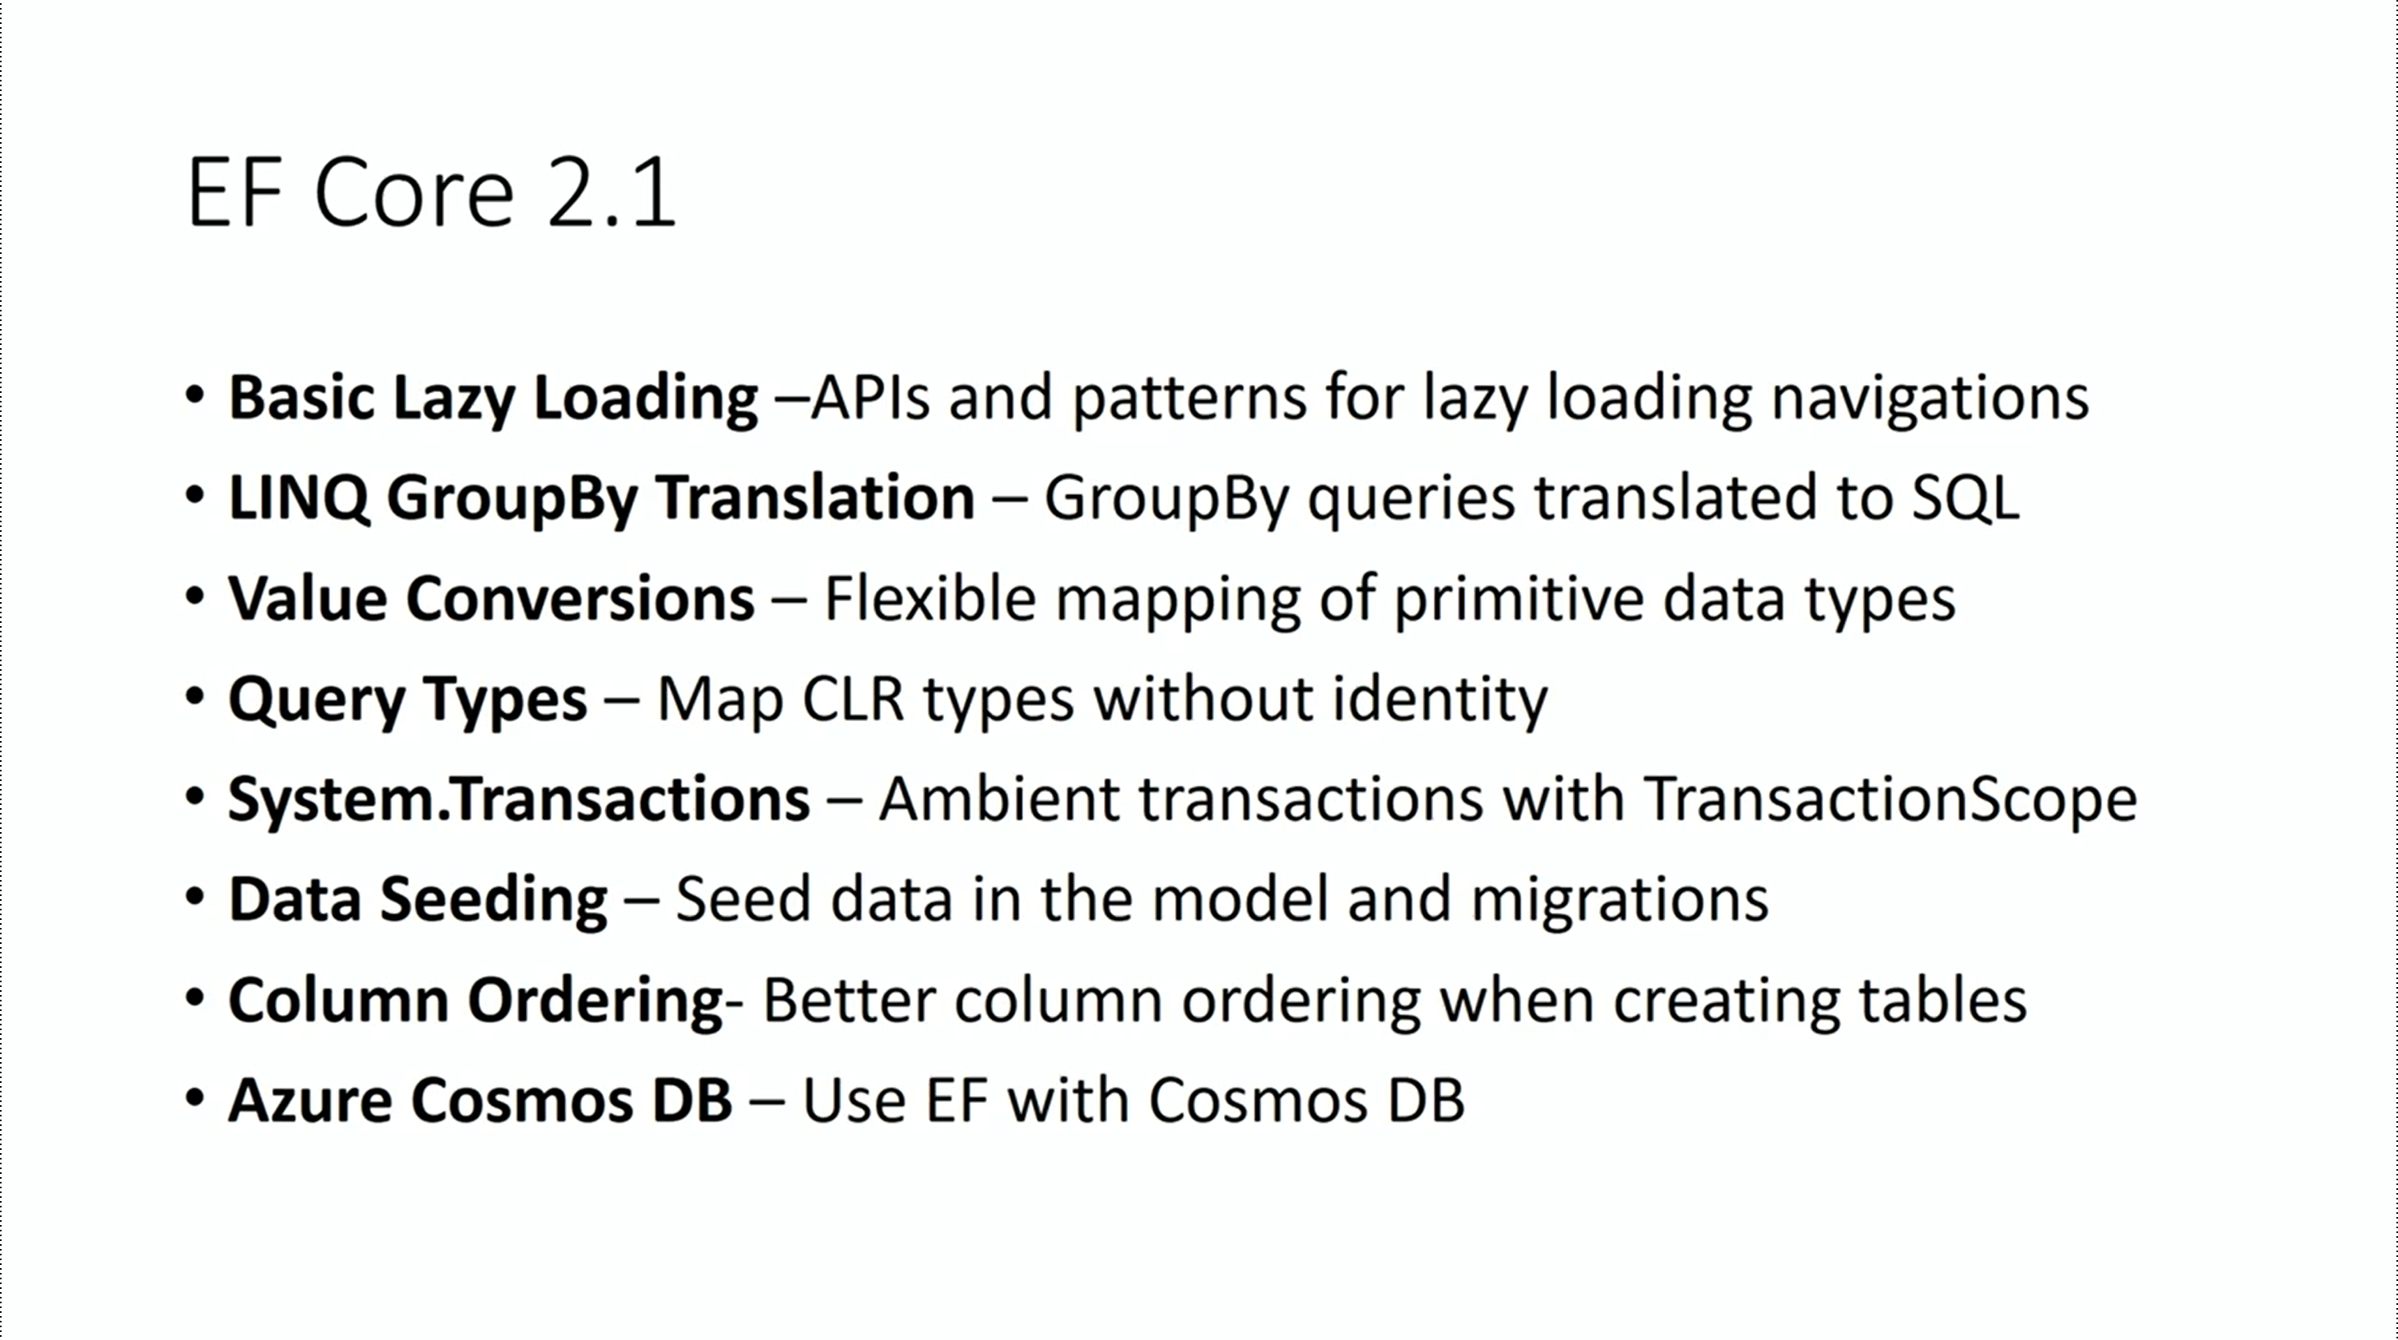

Slide 63
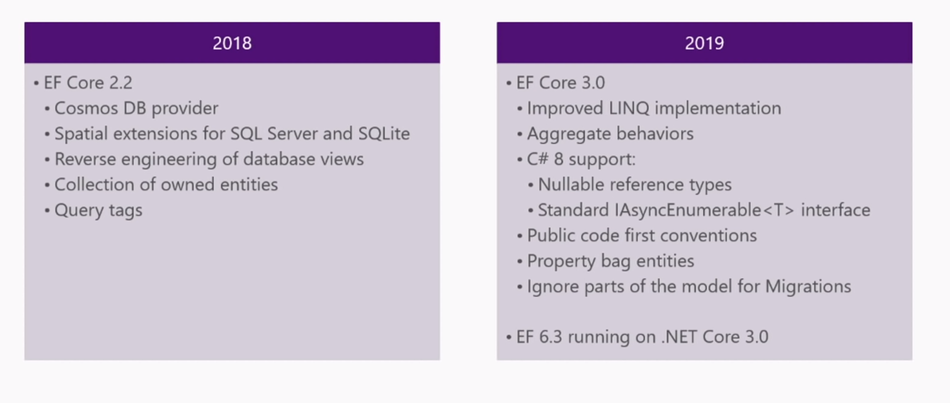
EF Core 2.2 and 3.0

Slide 64

Pluralsight Courses by Julie Lerman
https://www.pluralsight.com/authors/julie-lerman

Slide 65
Visual Studio 2017 & VS Code
Notes:
ASP .NET 5.0

Slide 66
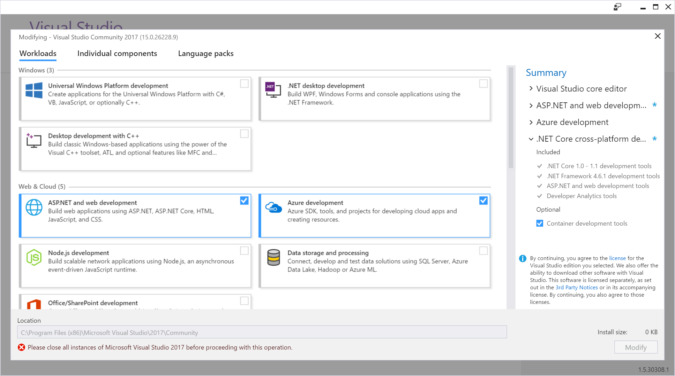
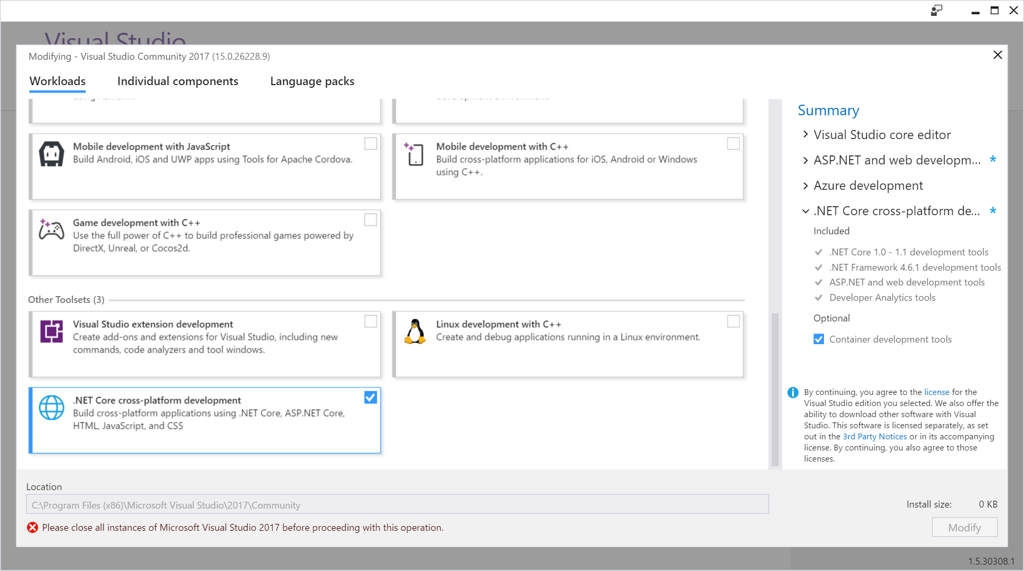
New Installer!

Slide 67
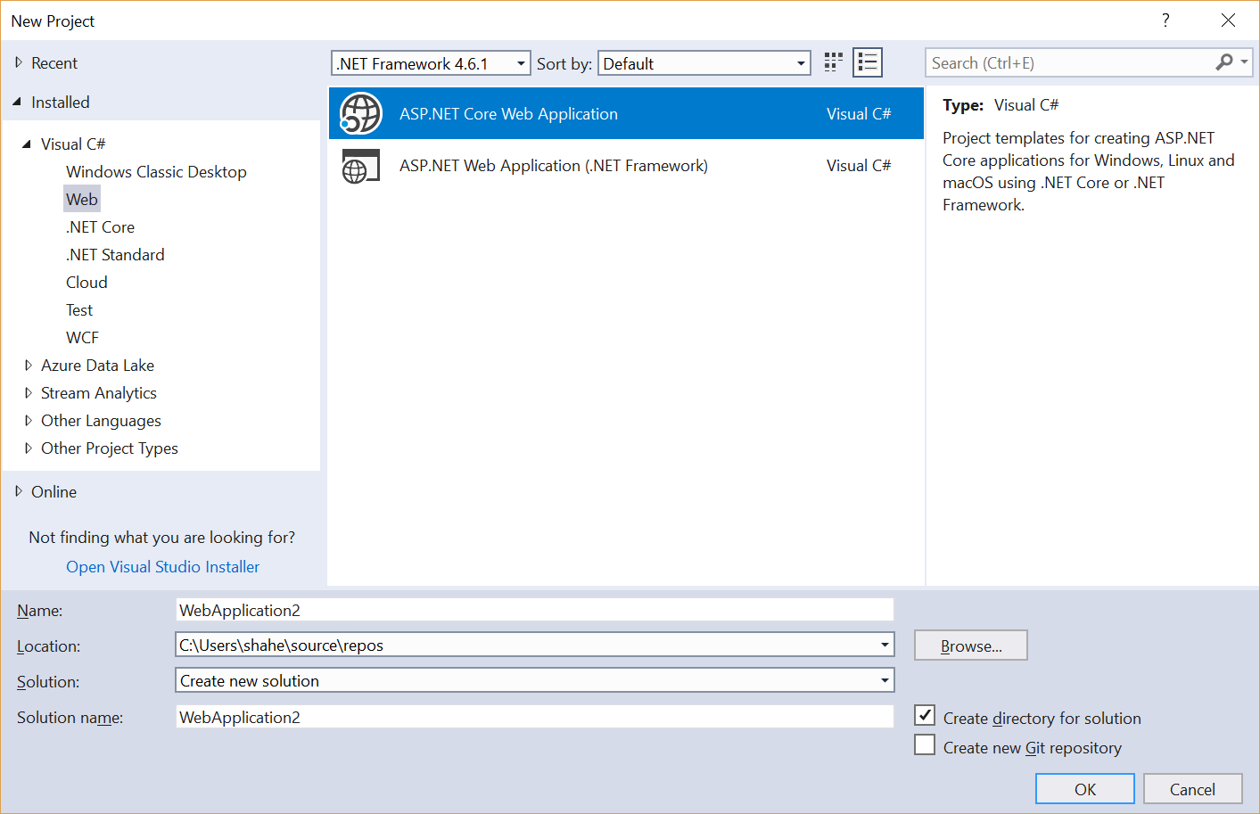
File → New Project → Web
ASP .NET Core Web App
Web App (4.x)

Slide 68
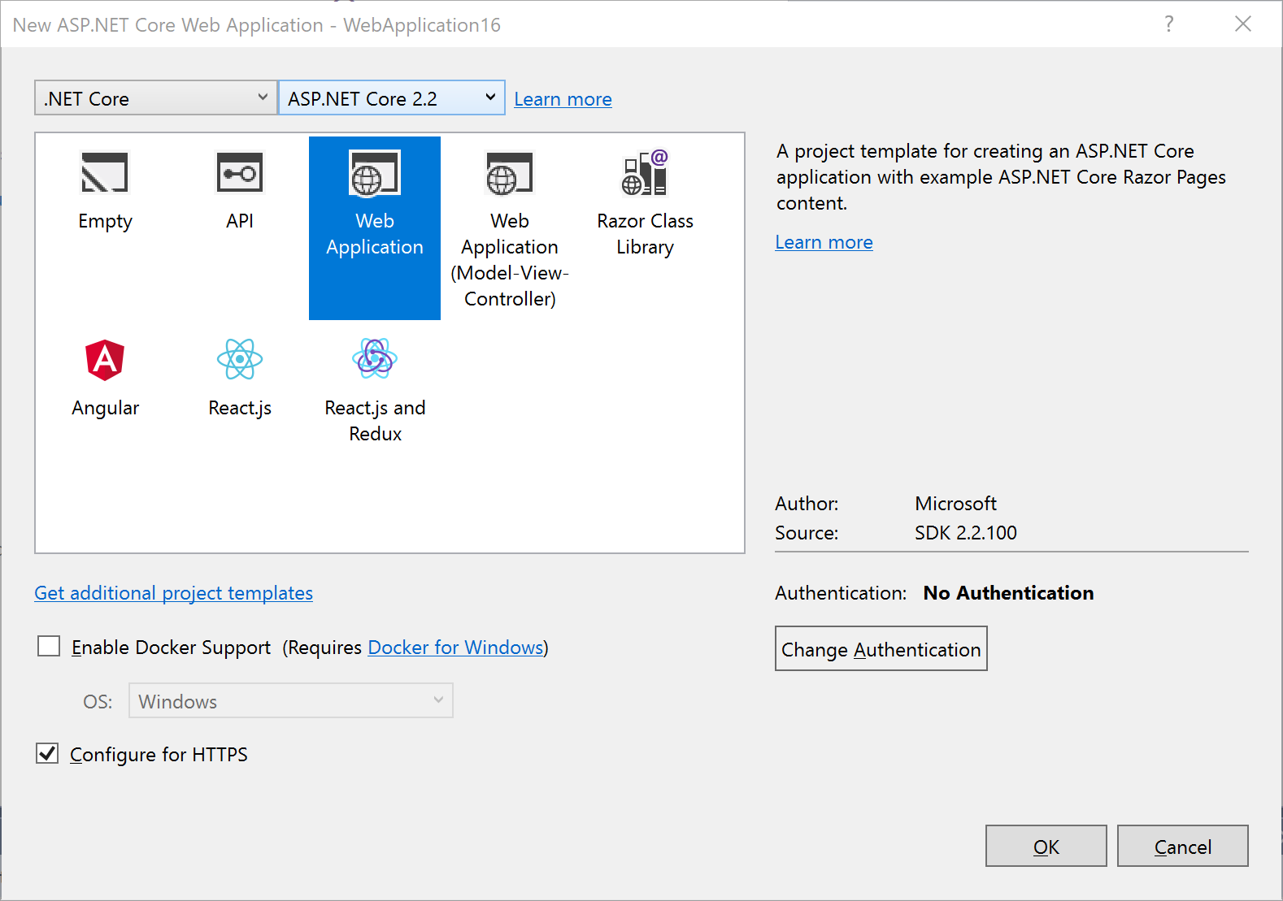
Select a Template
1.0 , 1.1, 2.0, 2.1 or 2.2
Empty
API
Web App (Razor)
Web App (MVC)
Razor Class Library
Angular
React.js
React.js & Redux
Other settings:
Authentication
Docker Support

Slide 69
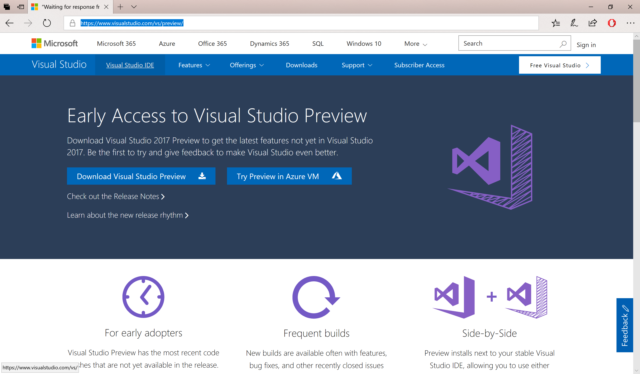
VS 2017 Preview with ASP.NET Core 2.1
https://www.visualstudio.com/vs/preview/

Slide 70
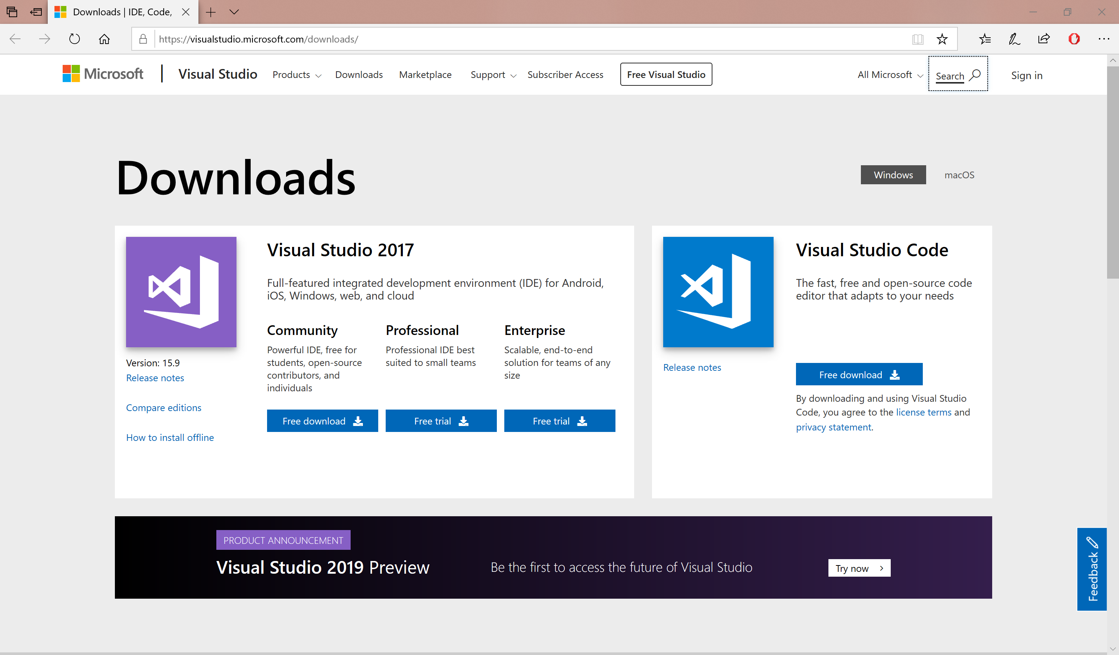
VS 2017 15.9 + ASP.NET Core 2.2
https://www.visualstudio.com/downloads

Slide 71
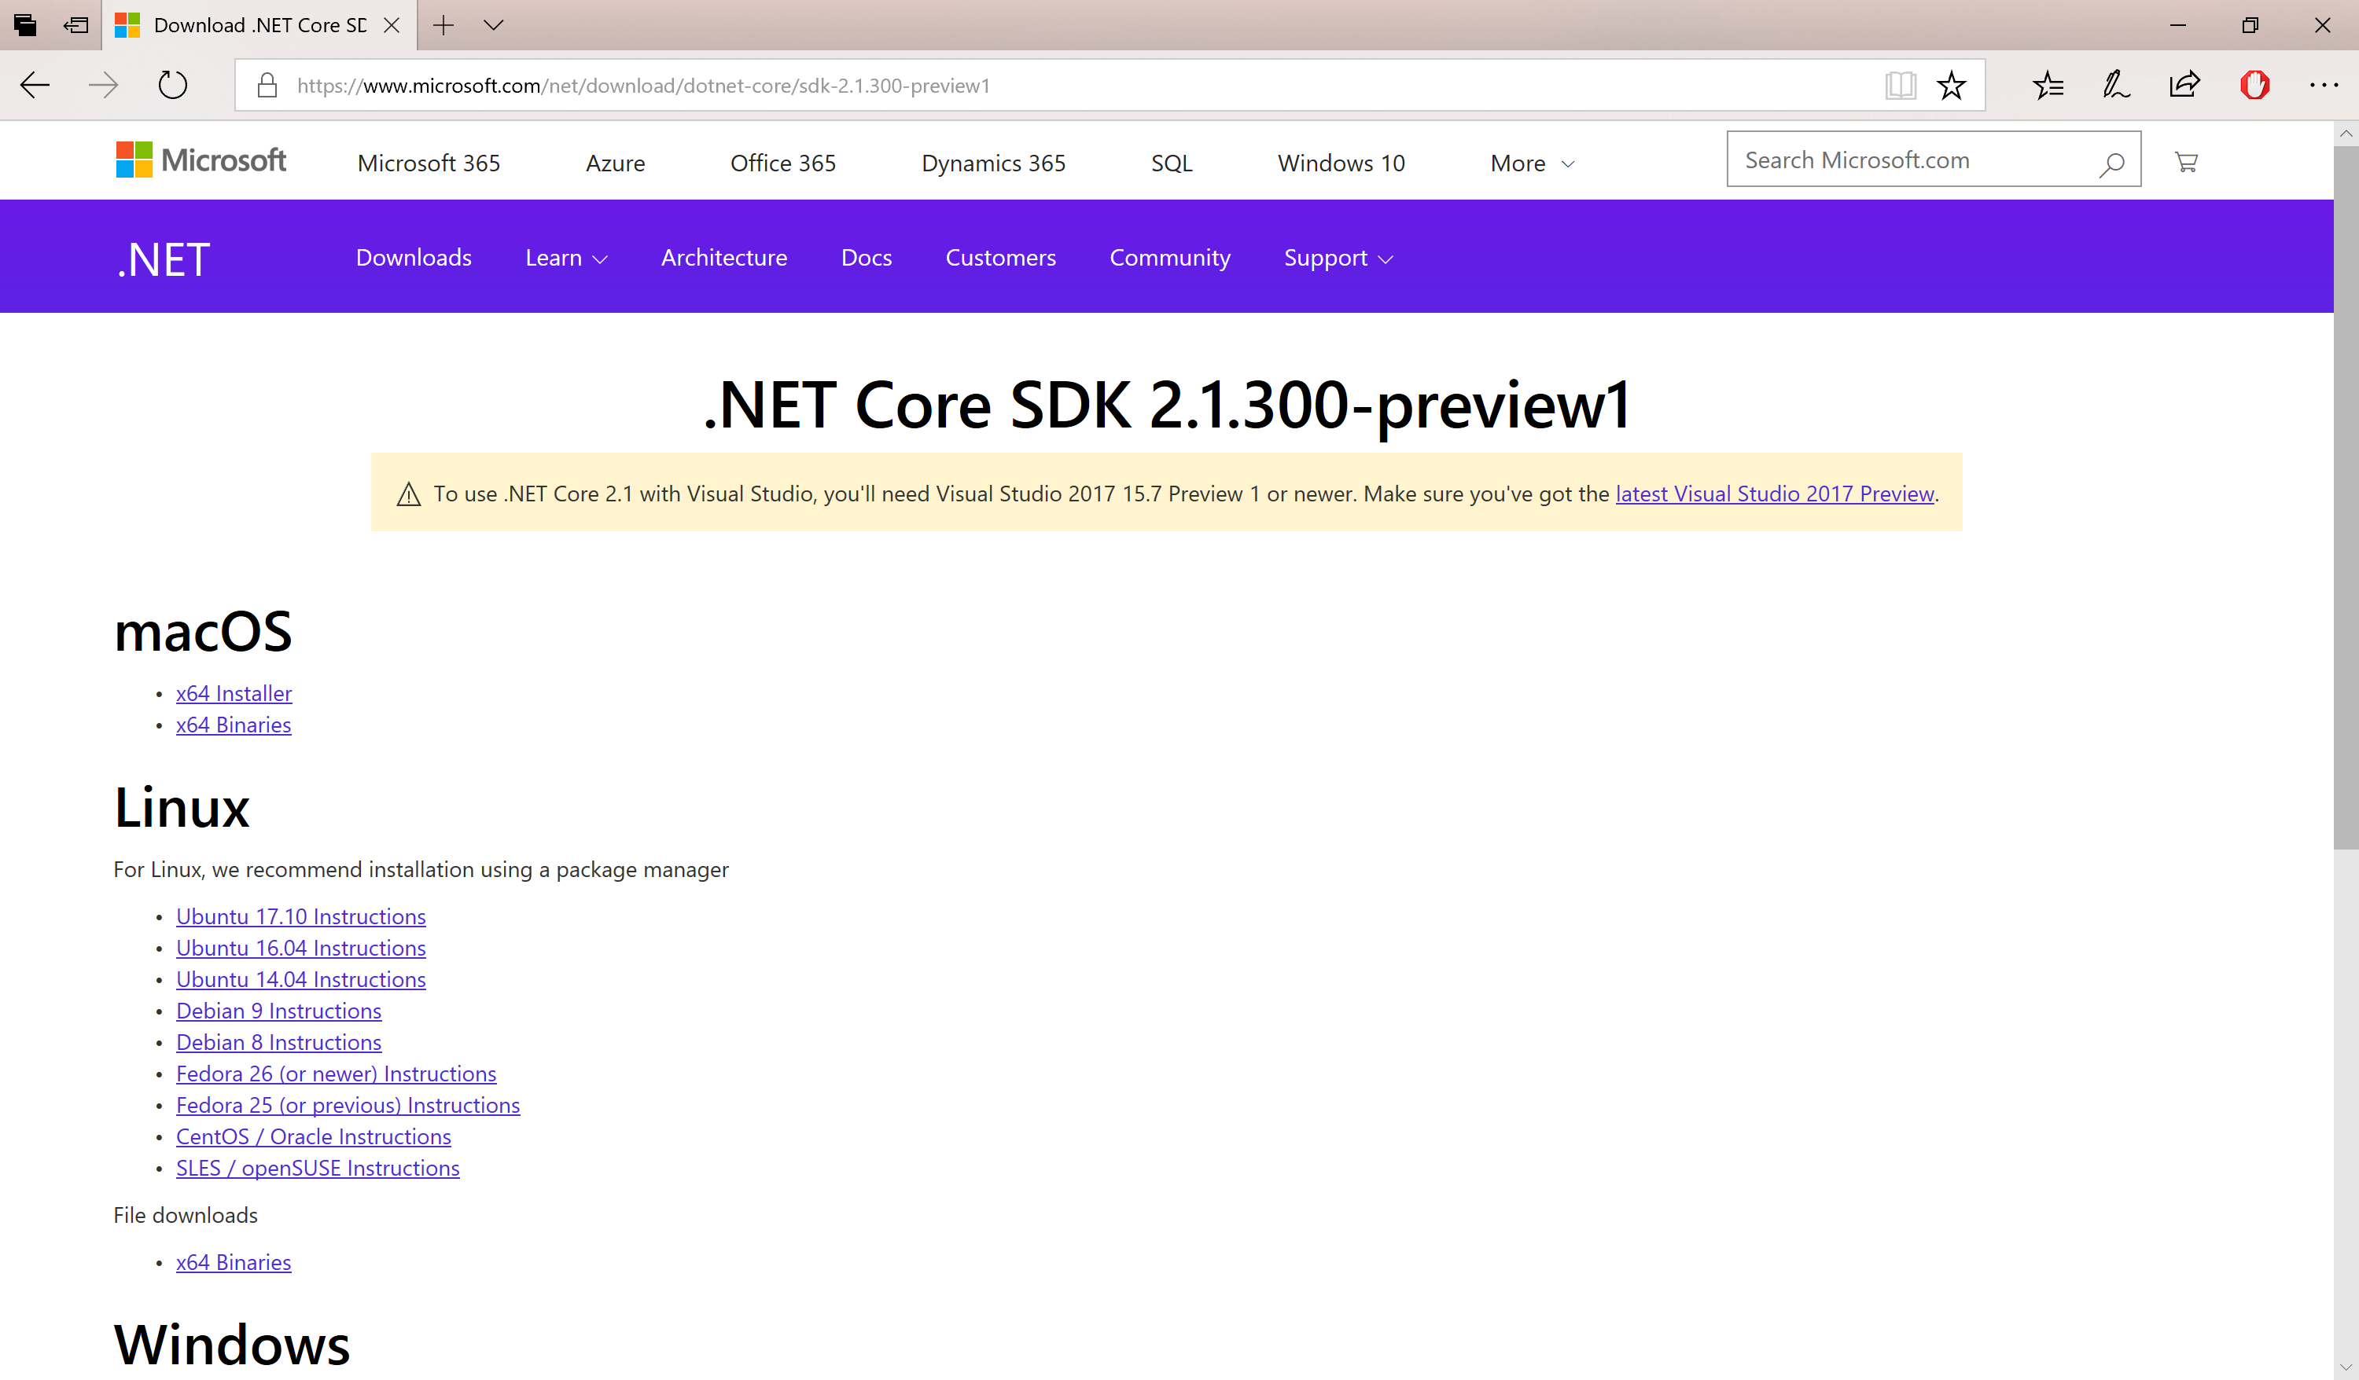
.NET Core SDK 2.1.300-preview1
https://www.microsoft.com/net/download/dotnet-core/sdk-2.1.300-preview1

Slide 72
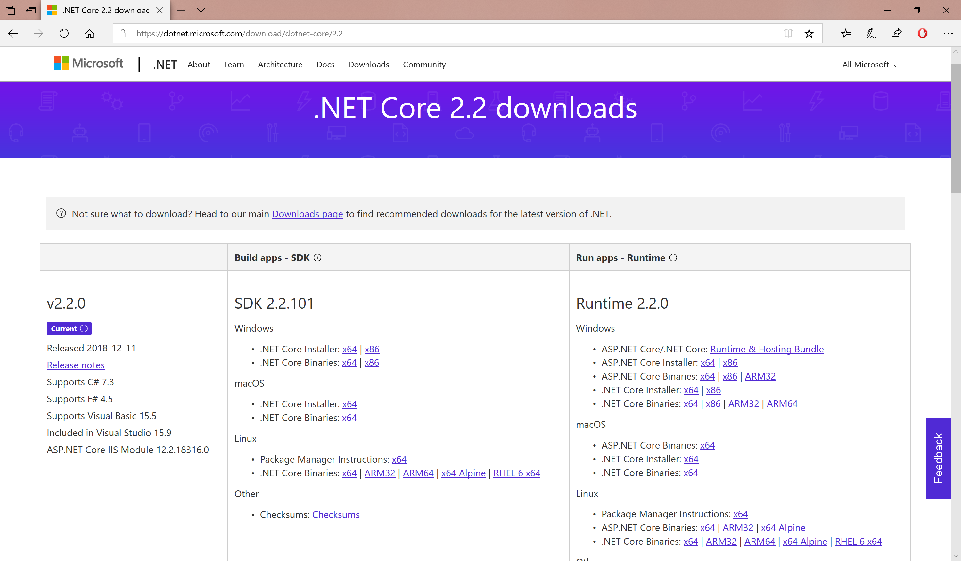
.NET Core SDK 2.2
https://dotnet.microsoft.com/download/dotnet-core/2.2

Slide 73
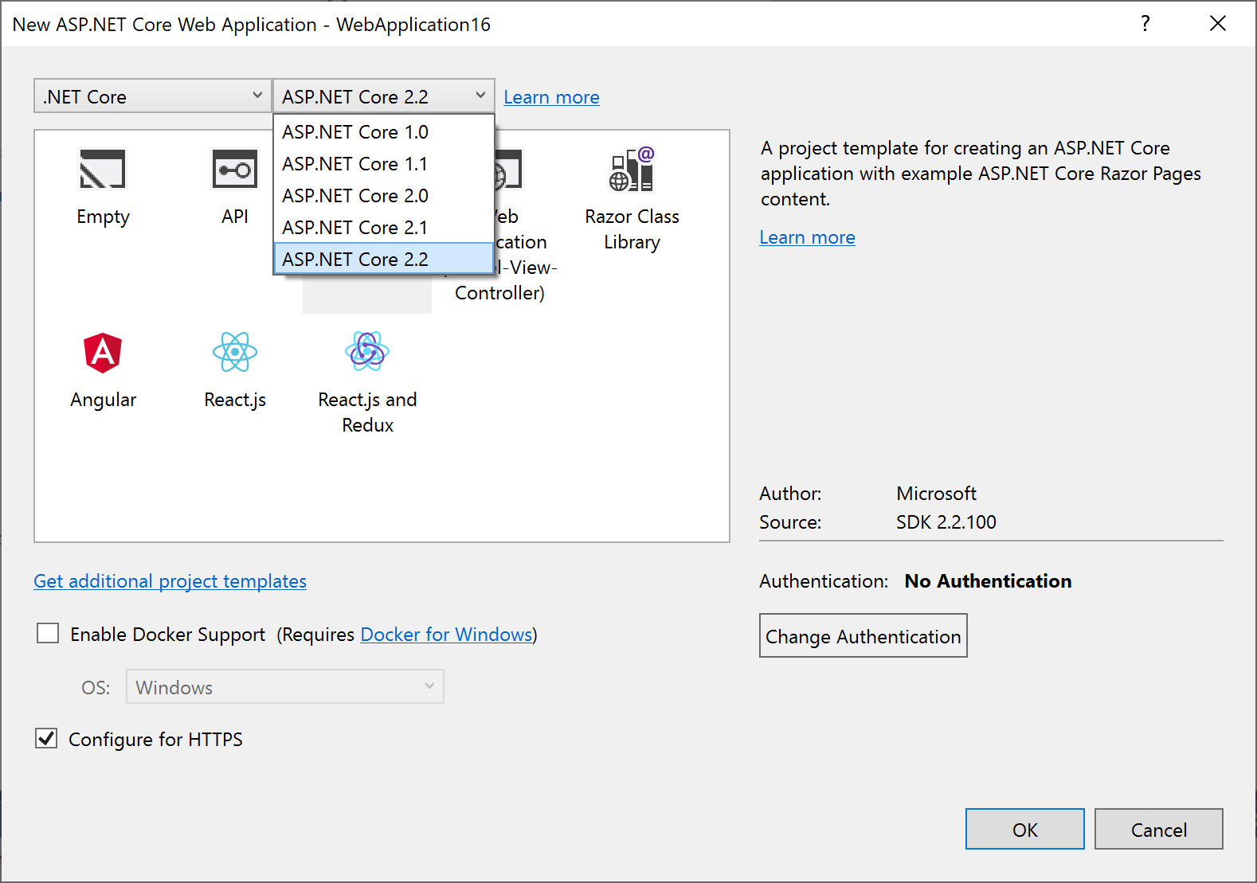
Select a Template (VS 2017 15.9)
Includes:
ASP .NET Core 2.2

Slide 74
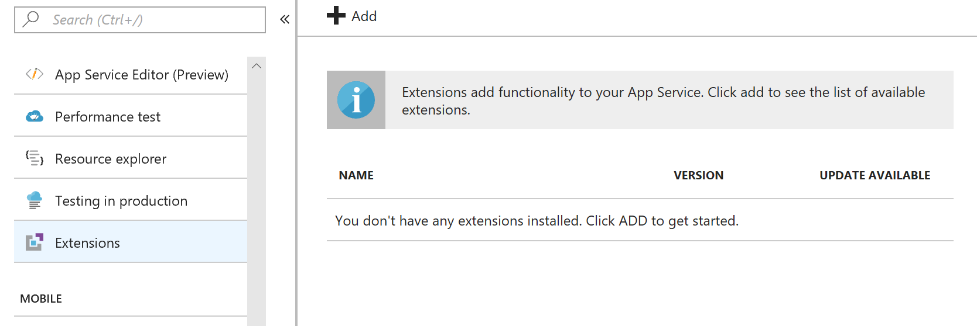
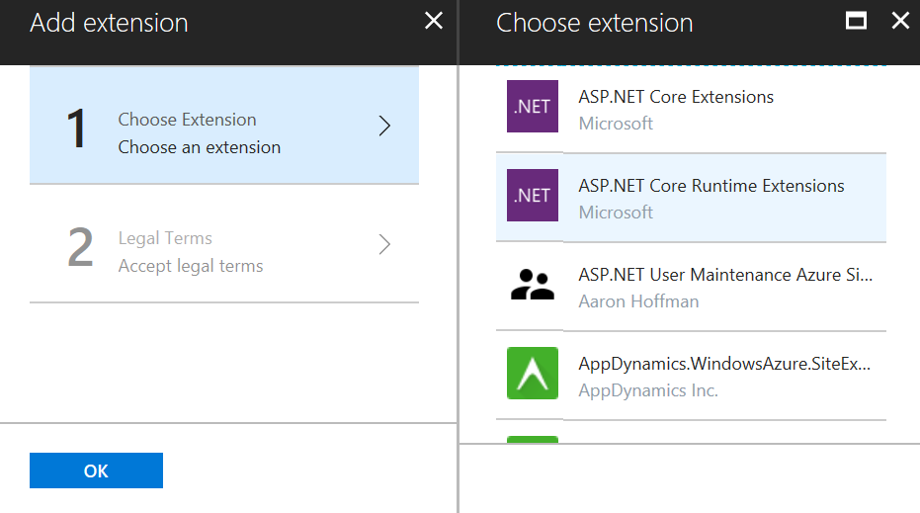
ASP.NET Core Runtime Extension on Azure
https://blogs.msdn.microsoft.com/webdev/2018/02/27/asp-net-core-2-1-0-preview1-using-asp-net-core-previews-on-azure-app-service/

Slide 75
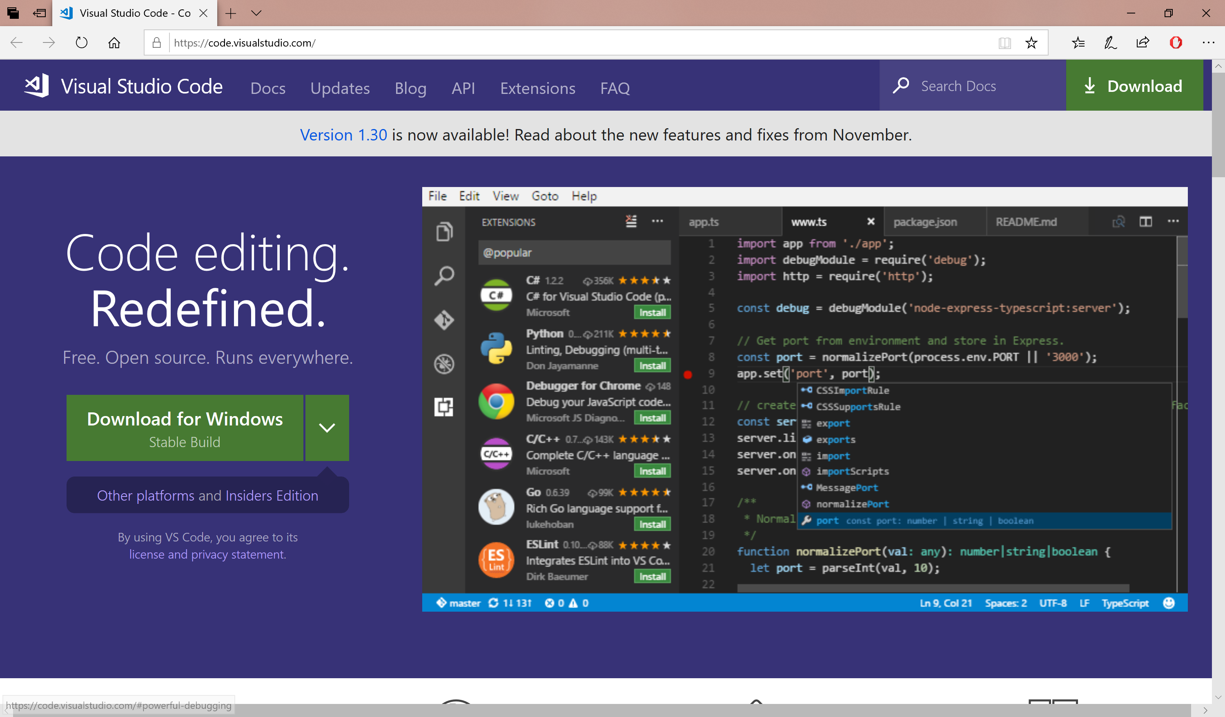
Visual Studio Code
Download: https://code.visualstudio.com

Slide 76
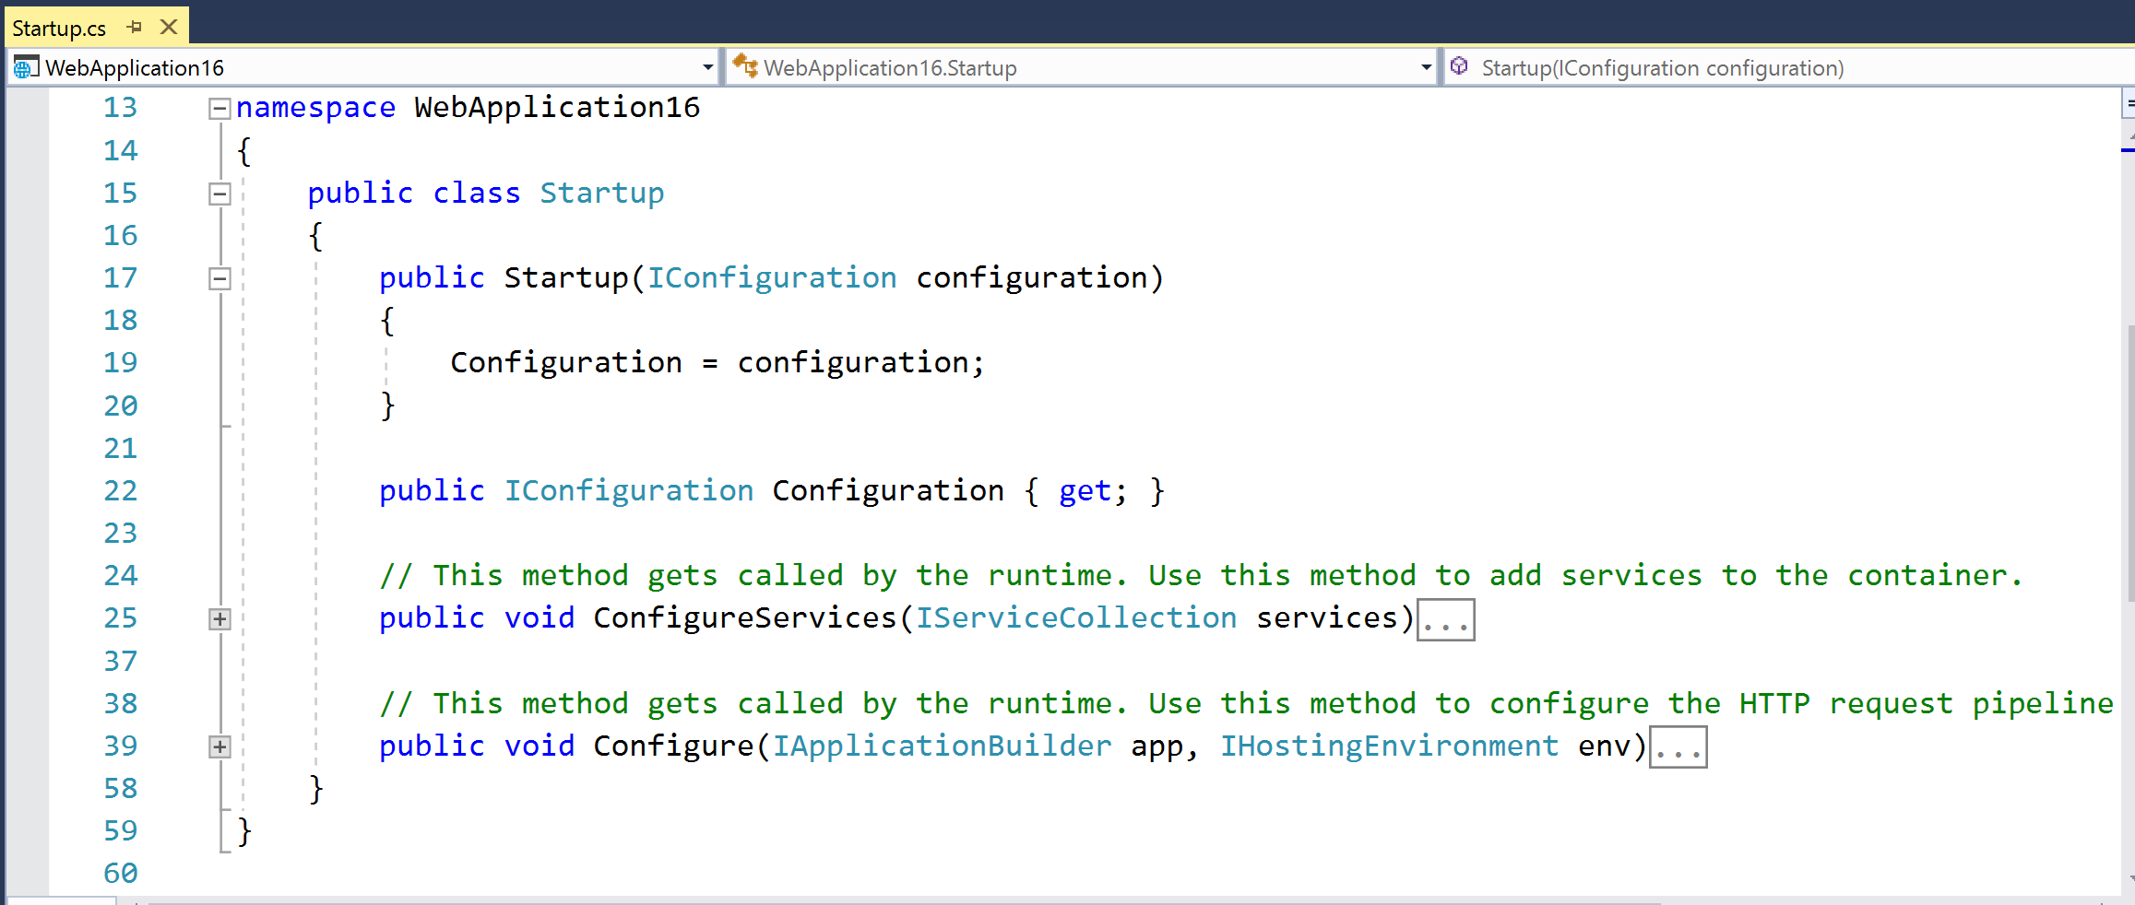
Startup.cs Configuration

Slide 77
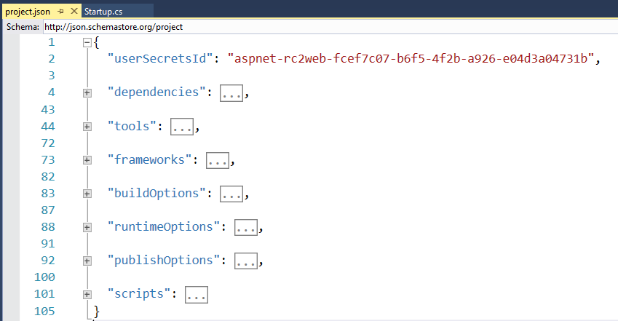
project.json

Slide 78
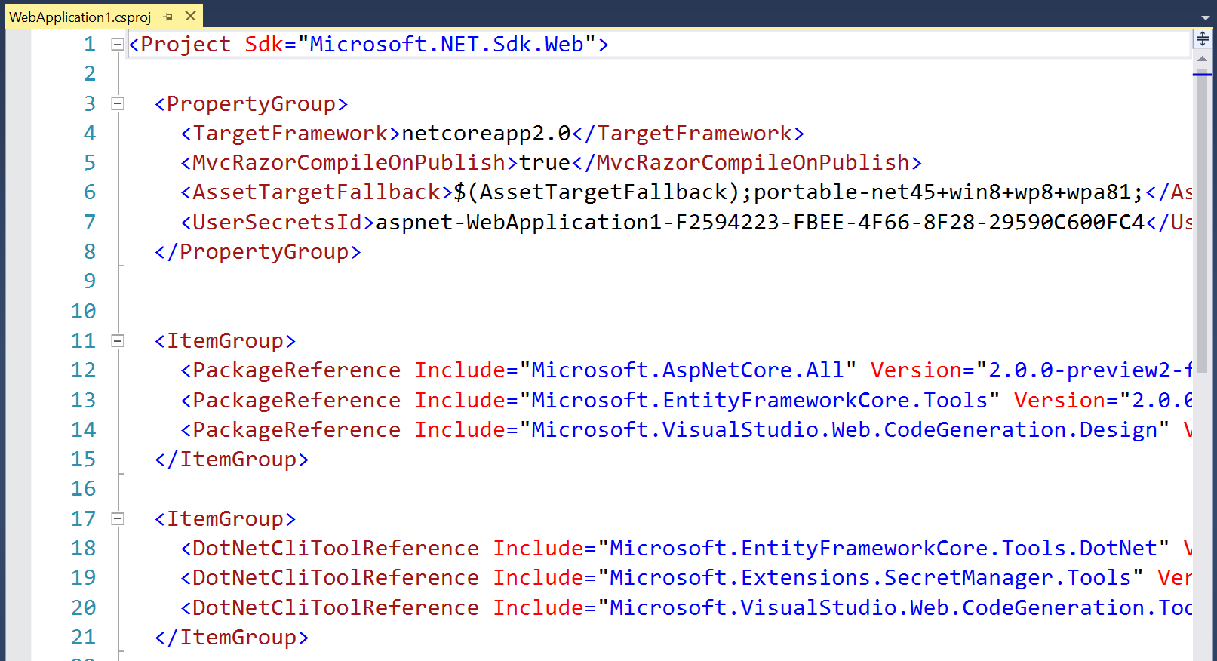
.csproj project file 2.0

Slide 79
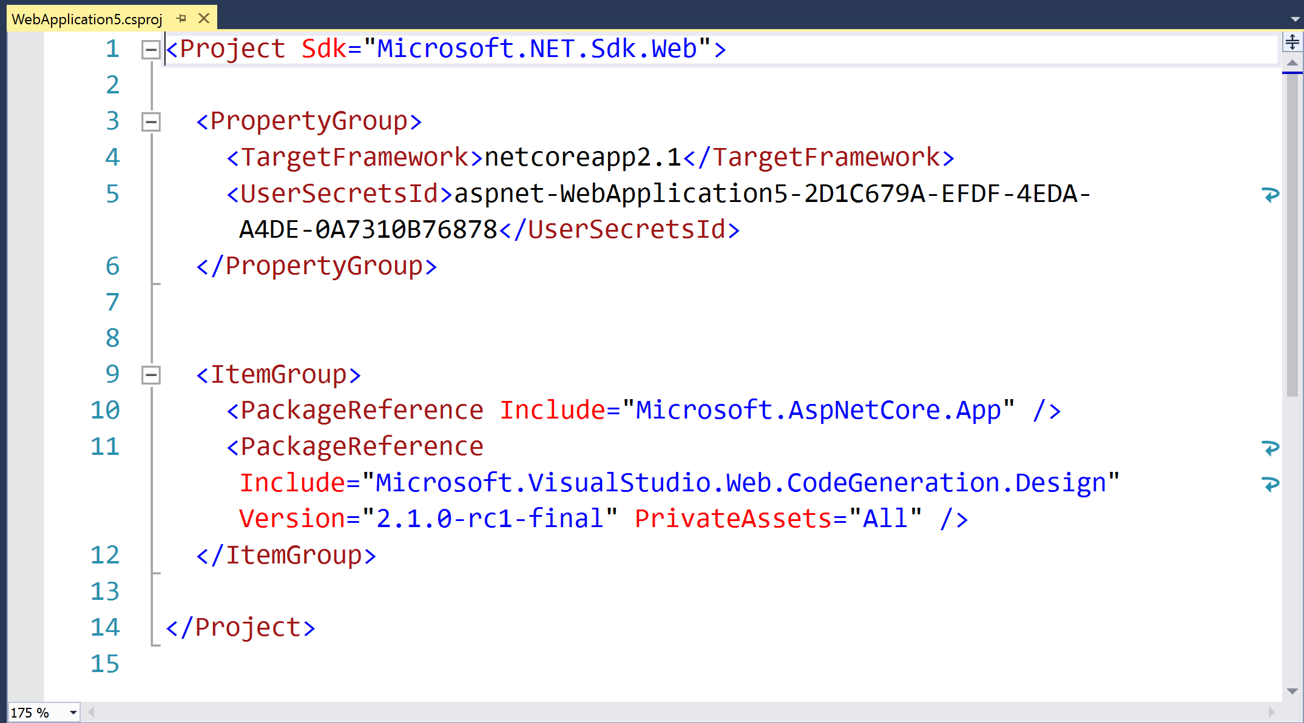
.csproj project file 2.1

Slide 80
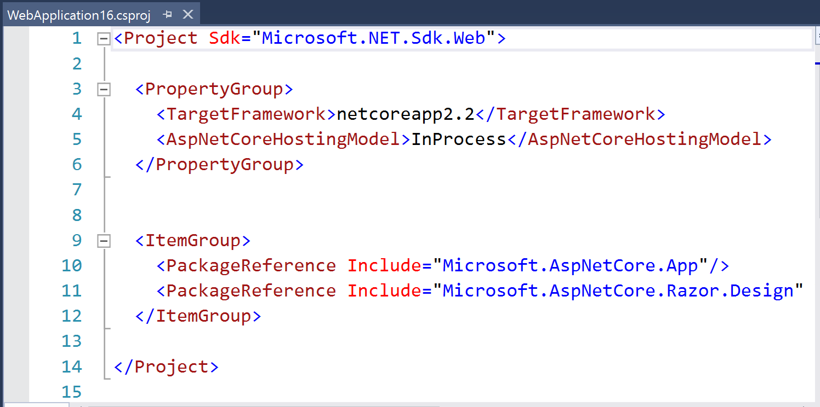
.csproj project file 2.2

Slide 81
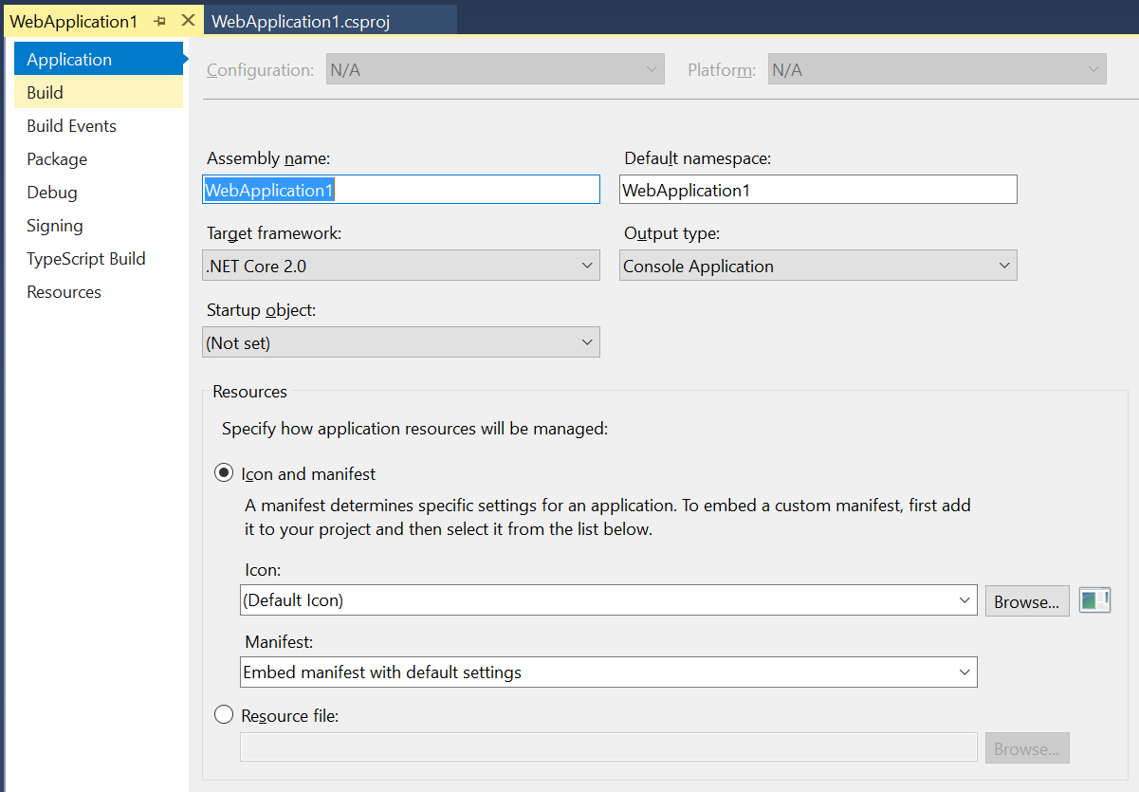
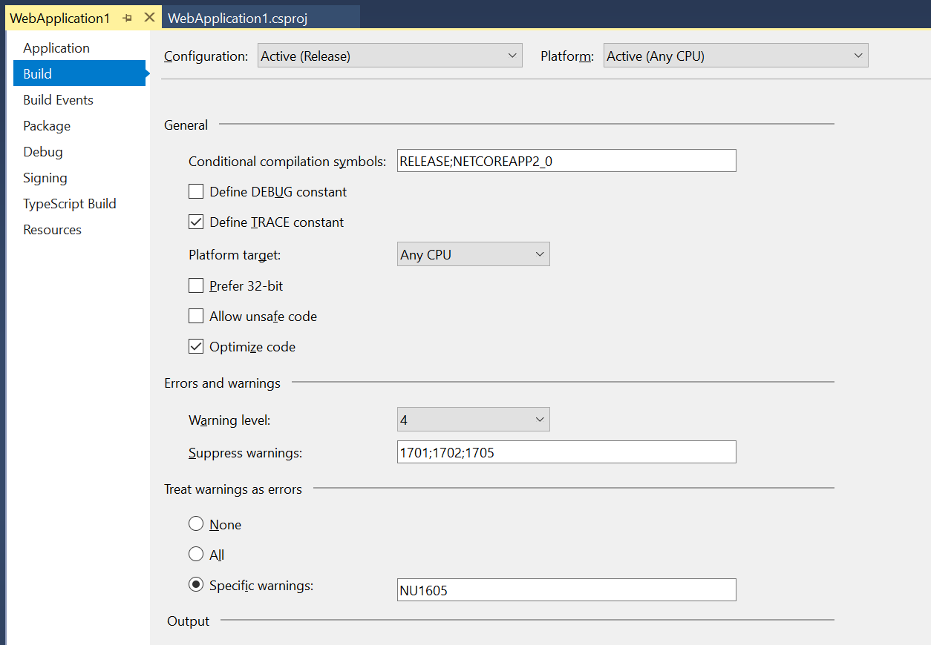
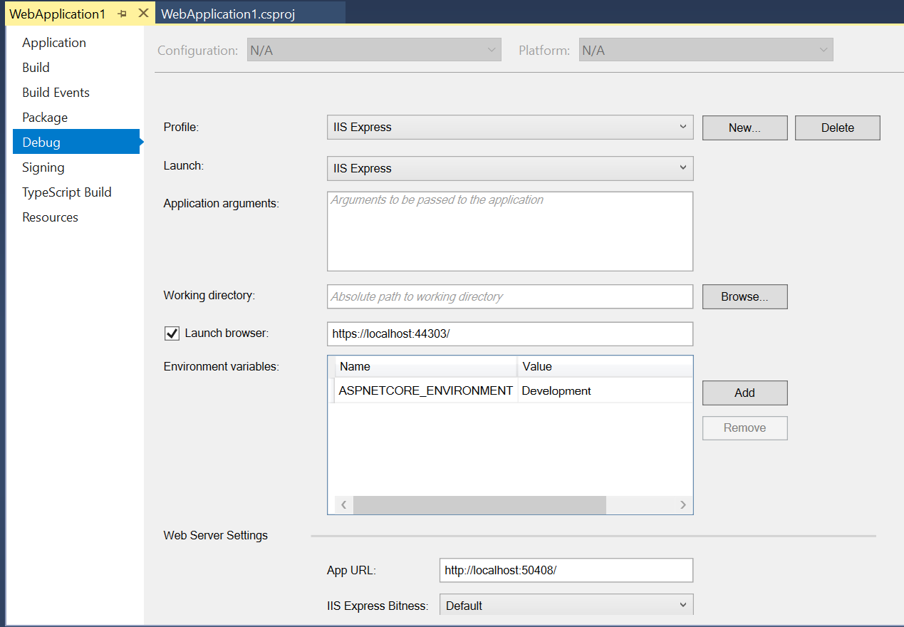
Right-click → (Project) Properties

Slide 82
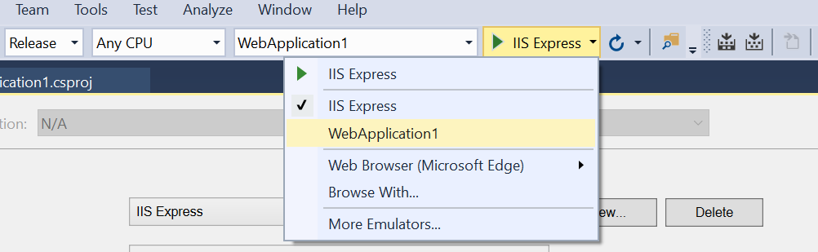
Choose Profile While Debugging

Slide 83
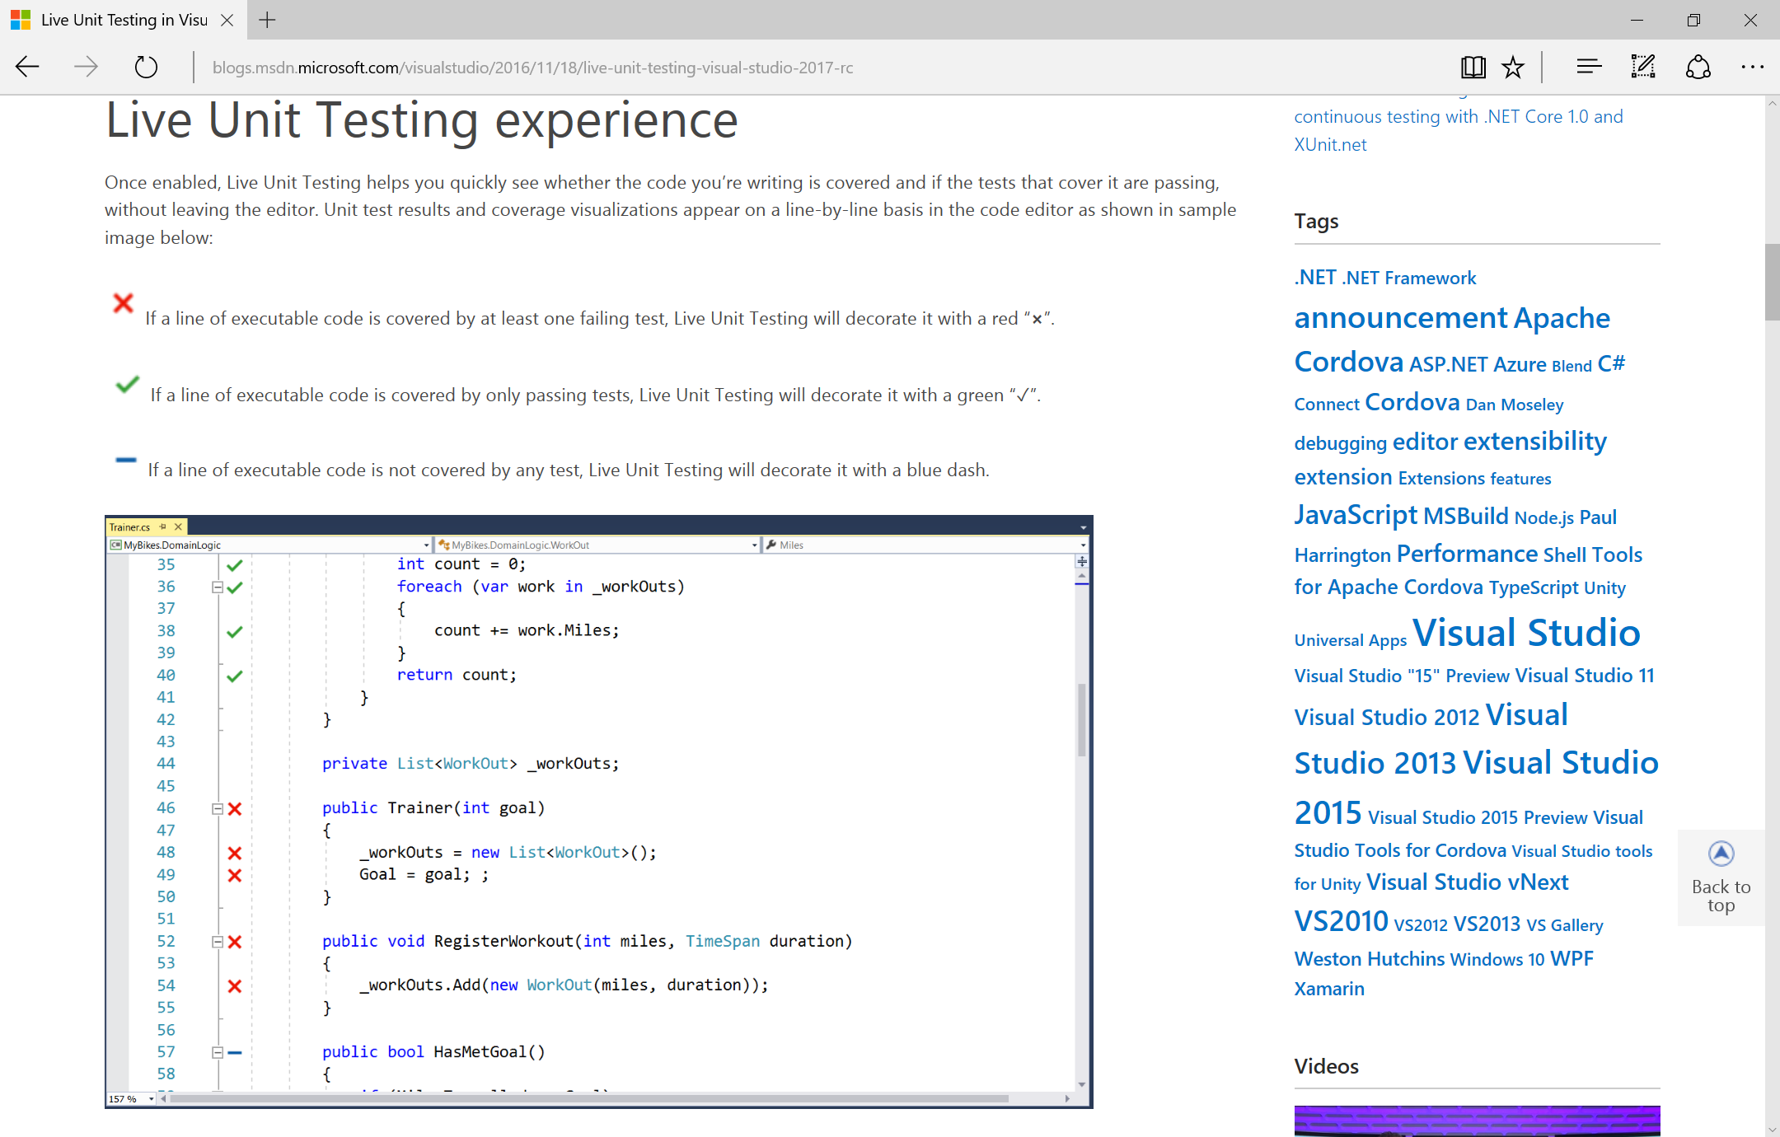
Live Unit Testing
https://blogs.msdn.microsoft.com/visualstudio/2016/11/18/live-unit-testing-visual-studio-2017-rc/

Slide 84
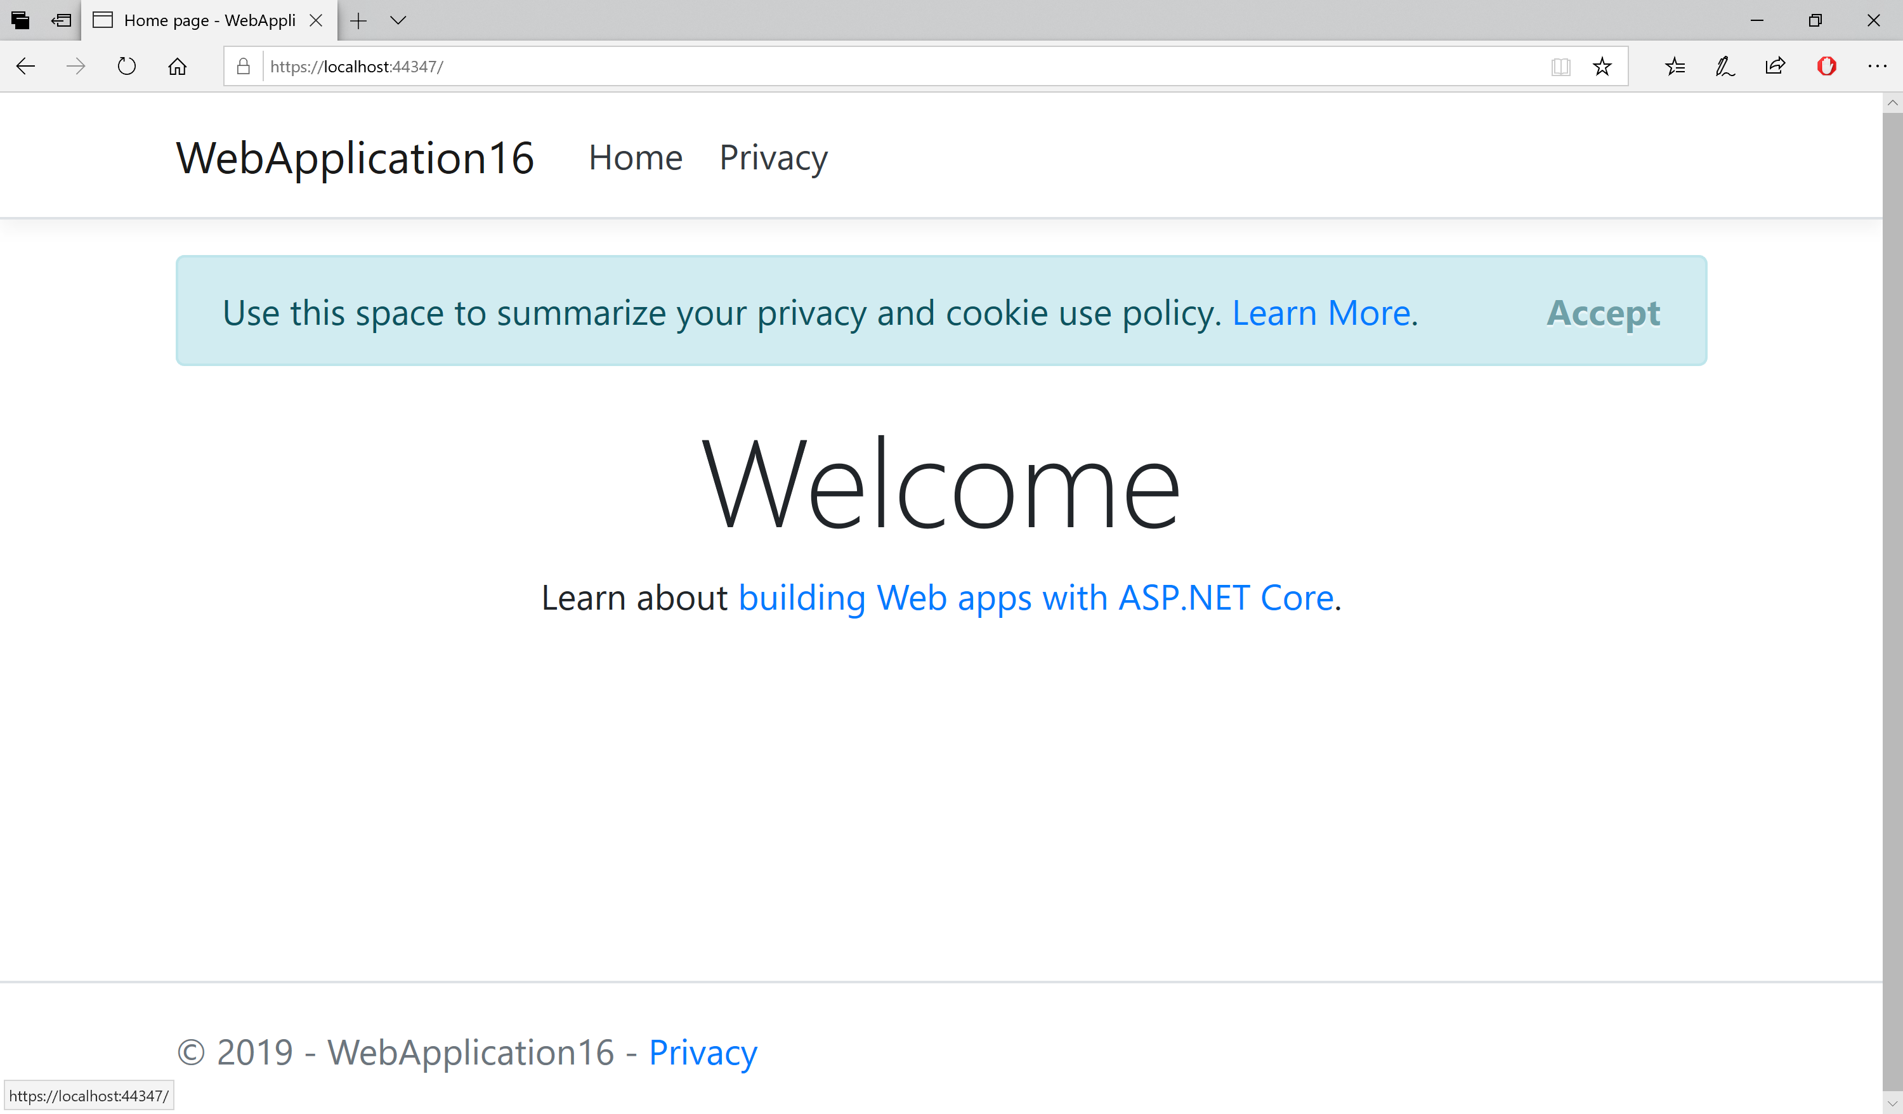
DEMO

Slide 85
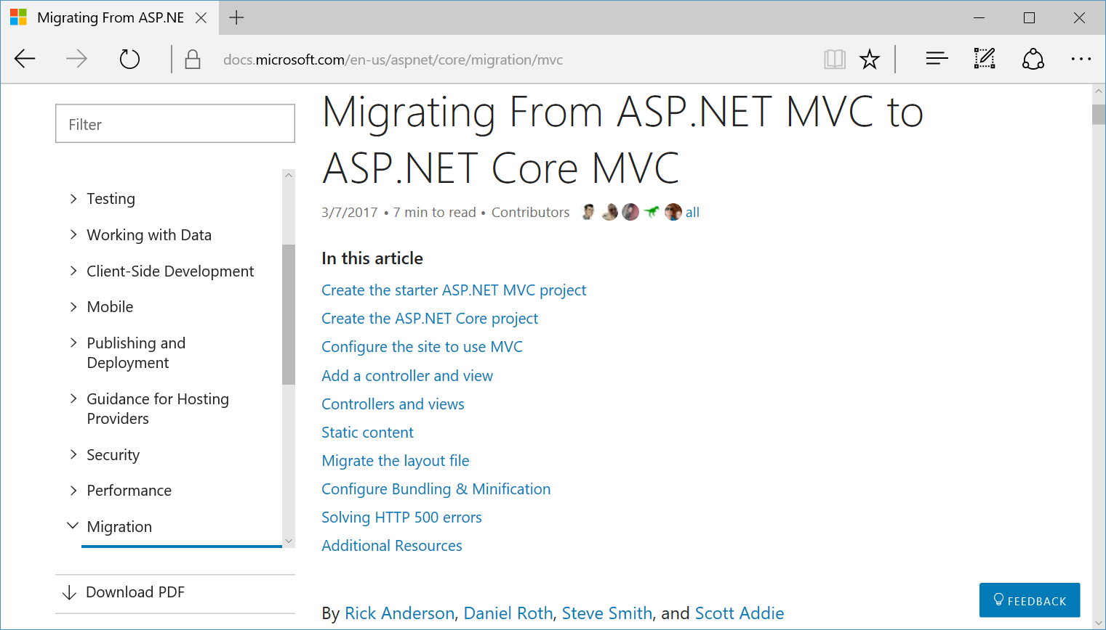
Migrating from MVC to MVC Core
https://docs.microsoft.com/en-us/aspnet/core/migration/mvc

Slide 86
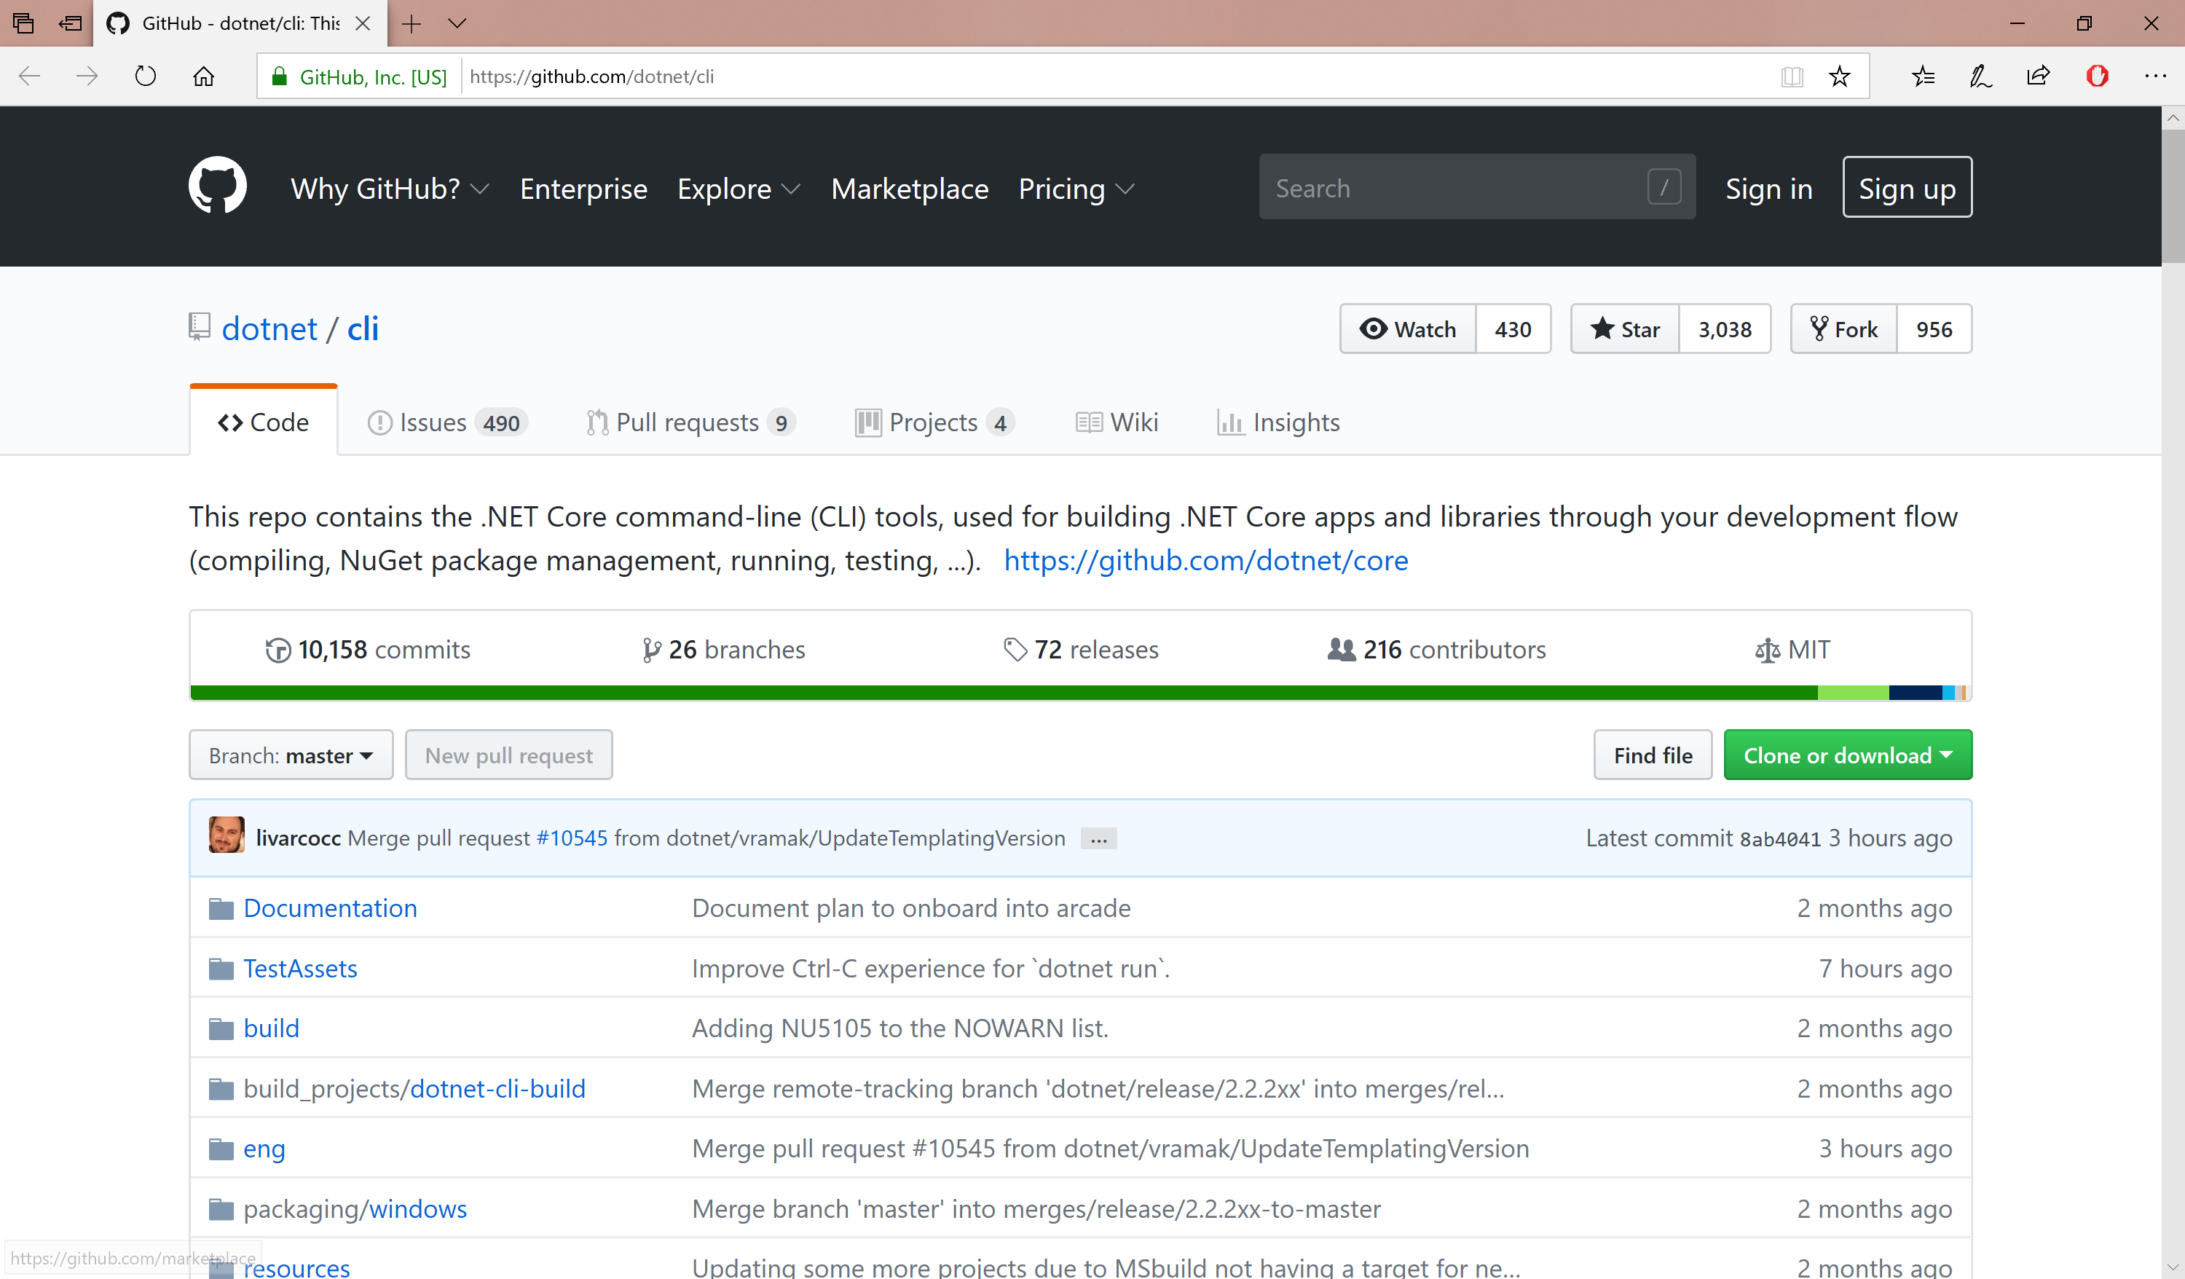
dotnet/cli on GitHub
This repo contains the .NET Core command-line (CLI) tools, used for building .NET Core apps and libraries.
GitHub: https://github.com/dotnet/cli

Slide 87
.NET Core 2.x CLI Commands
>dotnet --version
>dotnet --info
>dotnet new <TEMPLATE> --auth <AUTH_TYPE> -o <OUTPUT_DIR>
<TEMPLATE> = web | mvc | razor | angular | react | webapi
<AUTH_TYPE> for mvc,razor = None | Individual | SingleOrg | Windows
>dotnet new console -o MyConsoleApp
>dotnet new mvc --auth Individual -o MyMvcWebApp
>dotnet restore
>dotnet build
>dotnet run
https://docs.microsoft.com/en-us/dotnet/core/tools/?tabs=netcore2x

Slide 88
Azure CLI Commands
>az login
>az group create -l <REGION> -n <RSG>
>az appservice plan create -g <RSG> -n <ASP> --sku <PLAN> (e.g. F1)
>az webapp create -g <RSG> -p <ASP> -n <APP>
RESULT → http://<APP>.azurewebsites.net
>git init
>git add .
>git commit -m "<COMMIT MESSAGE>“
>az webapp deployment user set --user-name <USER>
>az webapp deployment source config-local-git -g <RSG> -n <APP> --out tsv
>git remote add azure <GIT URL>
>git push azure master
GIT URL → https://<USER>@<APP>.scm.azurewebsites.net/<APP>.git
https://docs.microsoft.com/en-us/azure/app-service/scripts/app-service-cli-deploy-github

Slide 89
Agenda
Introduction
> .NET (Framework & Core)
> ASP.NET Core
> Visual Studio & VS Code
References + Wrap-up
Notes:
Agenda

Slide 90
References & Wrap-up
Notes:
Introduction

Slide 91
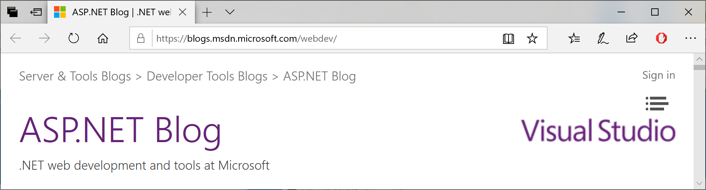
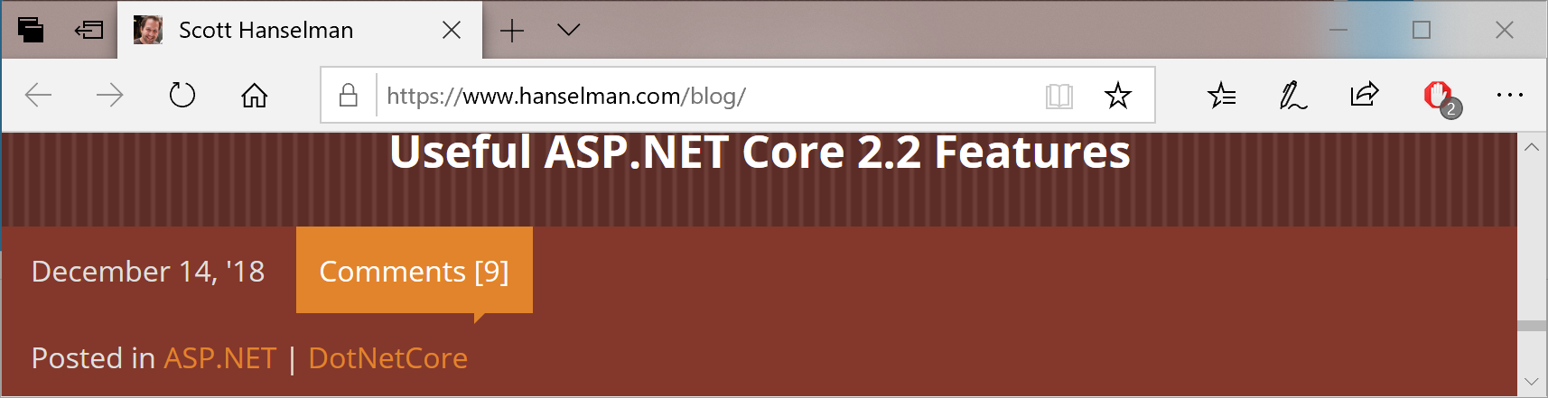
Blog Sources
ASP .NET Web Dev Blog: https://blogs.msdn.microsoft.com/webdev/
Scott Hanselman’s Blog: https://www.hanselman.com/blog/

Slide 92
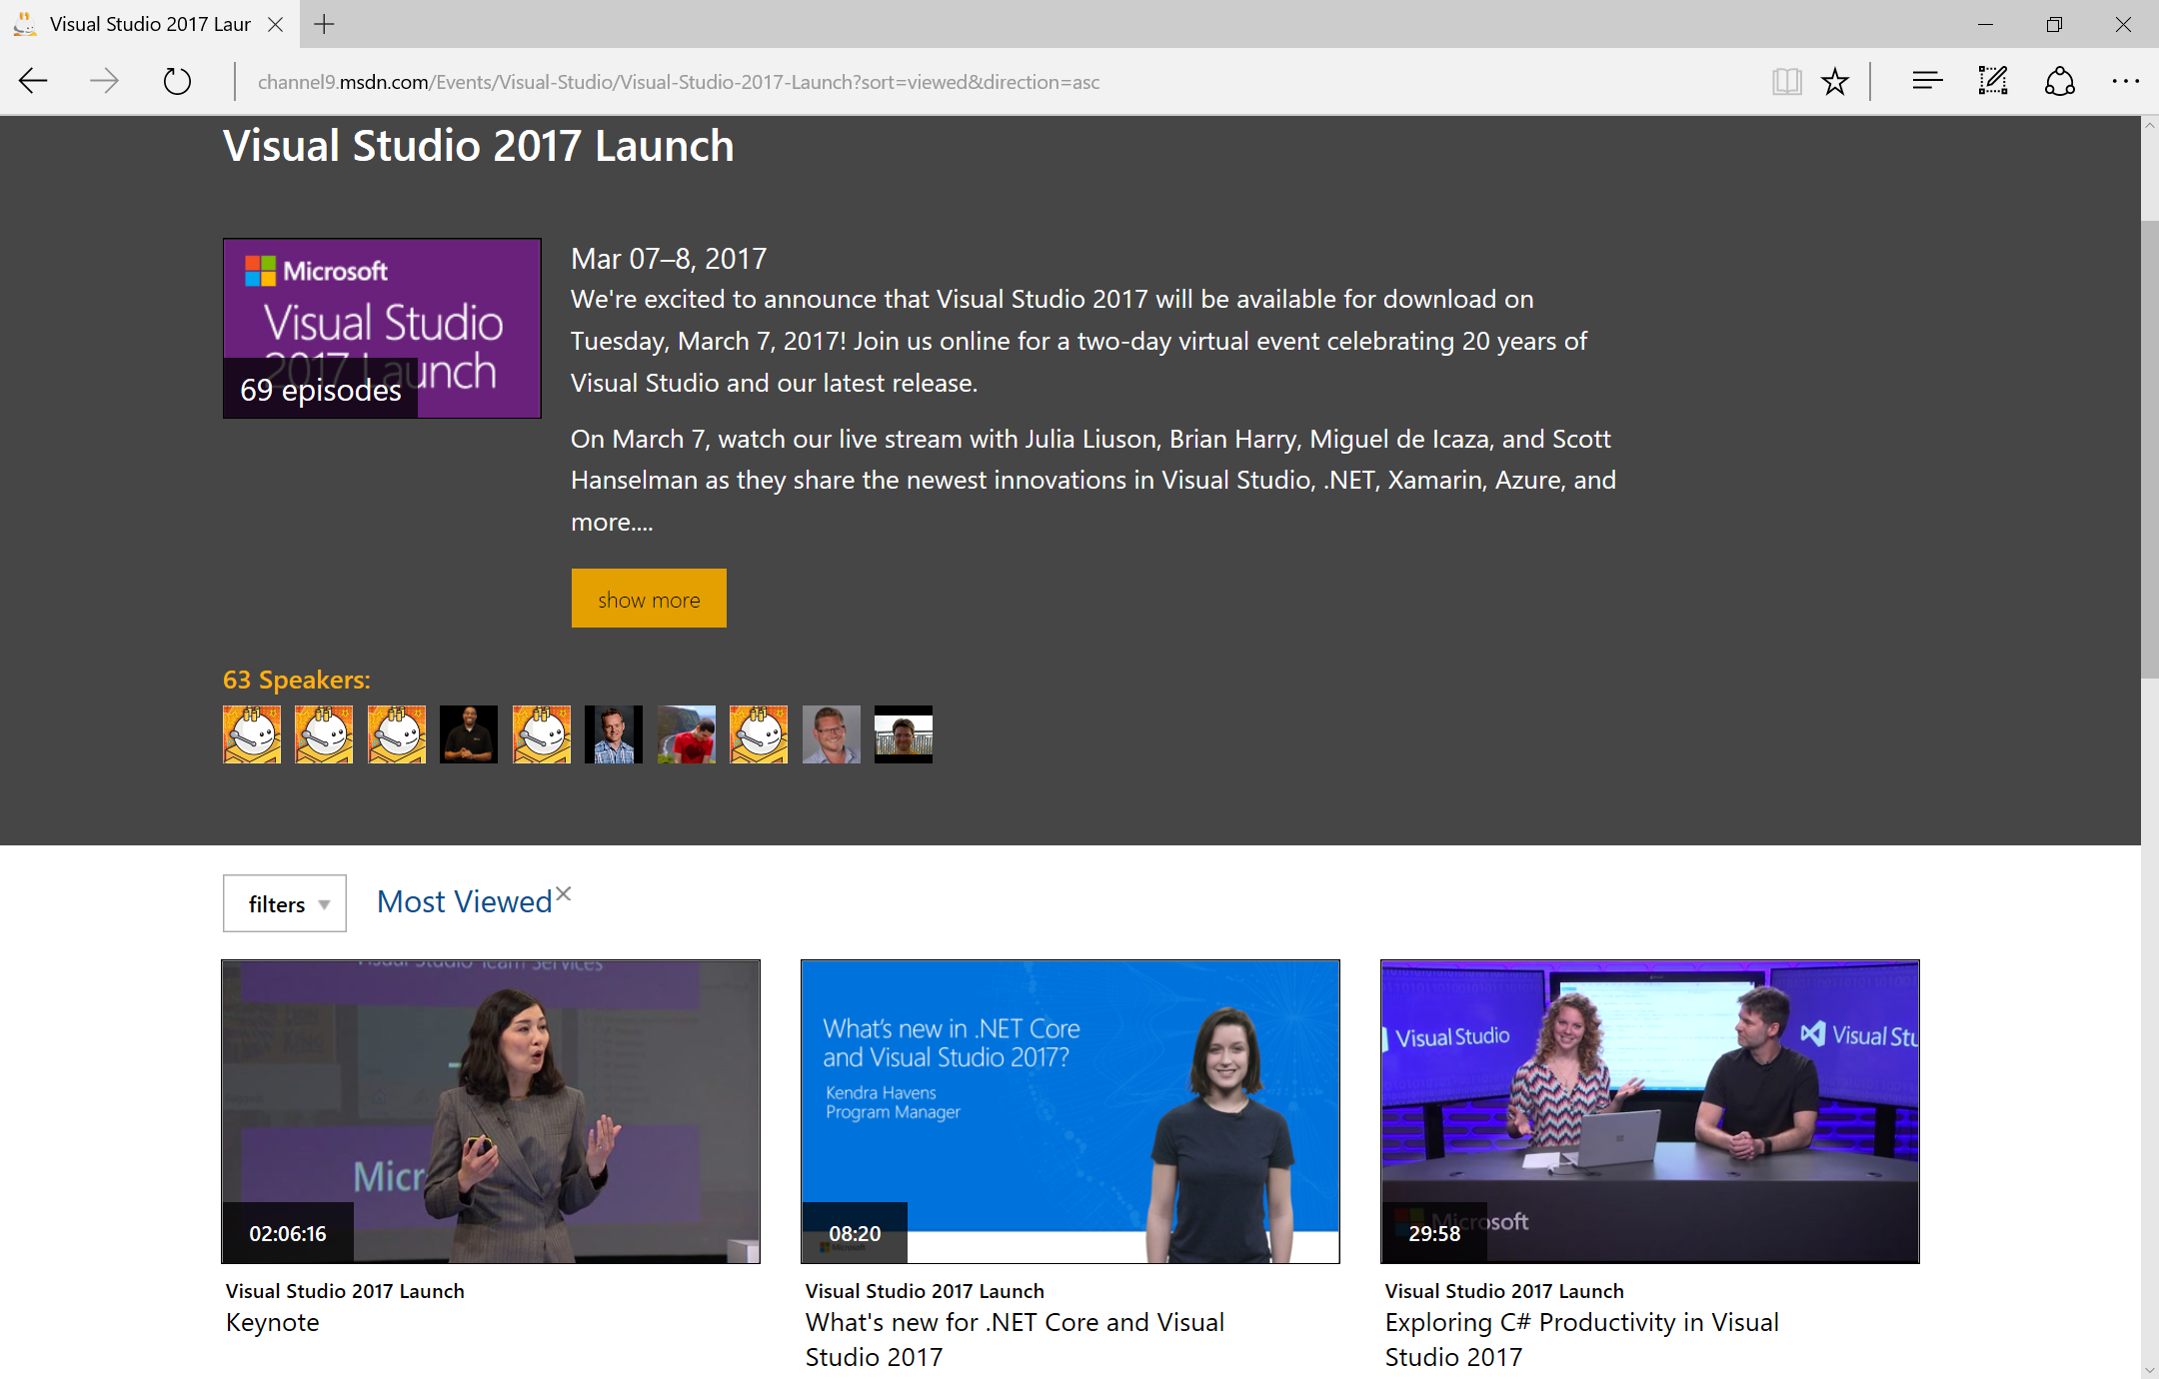
Visual Studio 2017 Launch Videos
https://channel9.msdn.com/Events/Visual-Studio/Visual-Studio-2017-Launch?sort=viewed&direction=asc

Slide 93
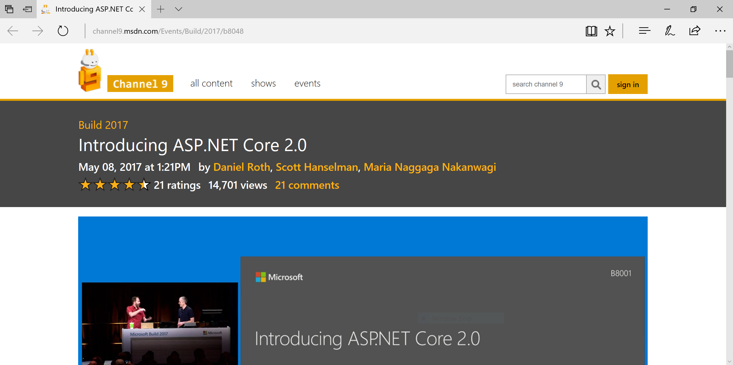
Build 2017: ASP .NET Core 2.0
https://channel9.msdn.com/Events/Build/2017/b8048

Slide 94
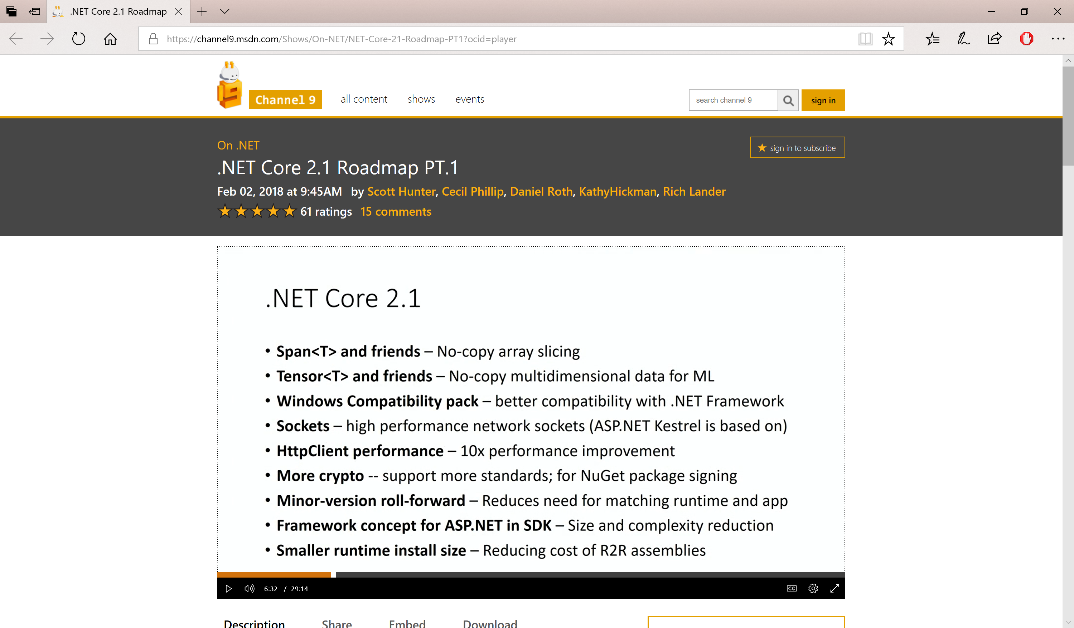
.NET Core 2.1 Roadmap PT.1
https://channel9.msdn.com/Shows/On-NET/NET-Core-21-Roadmap-PT1

Slide 95
.NET Core 2.1 Roadmap PT.2
https://channel9.msdn.com/Shows/On-NET/NET-Core-21-Roadmap-PT2

Slide 96
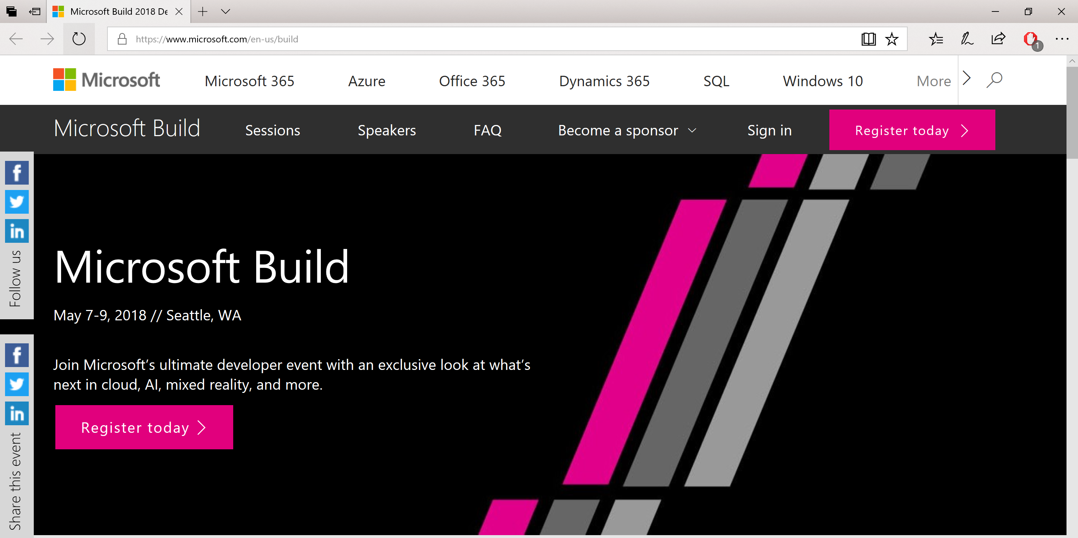
Build Conference 2018
http://build.microsoft.com

Slide 97
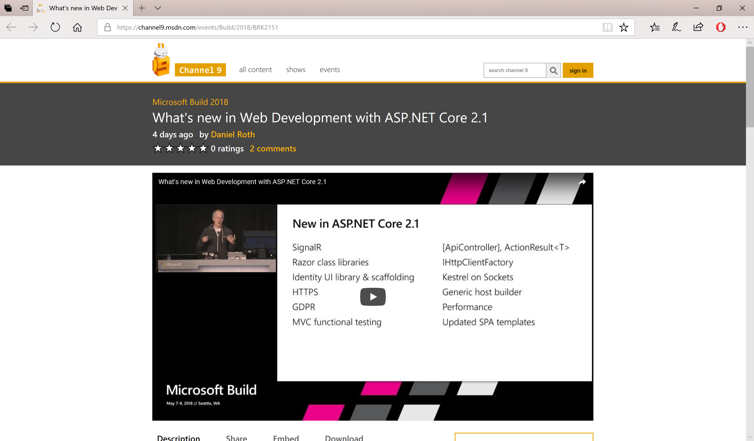
Build 2018: ASP .NET Core 2.1
https://channel9.msdn.com/events/Build/2018/BRK2151

Slide 98
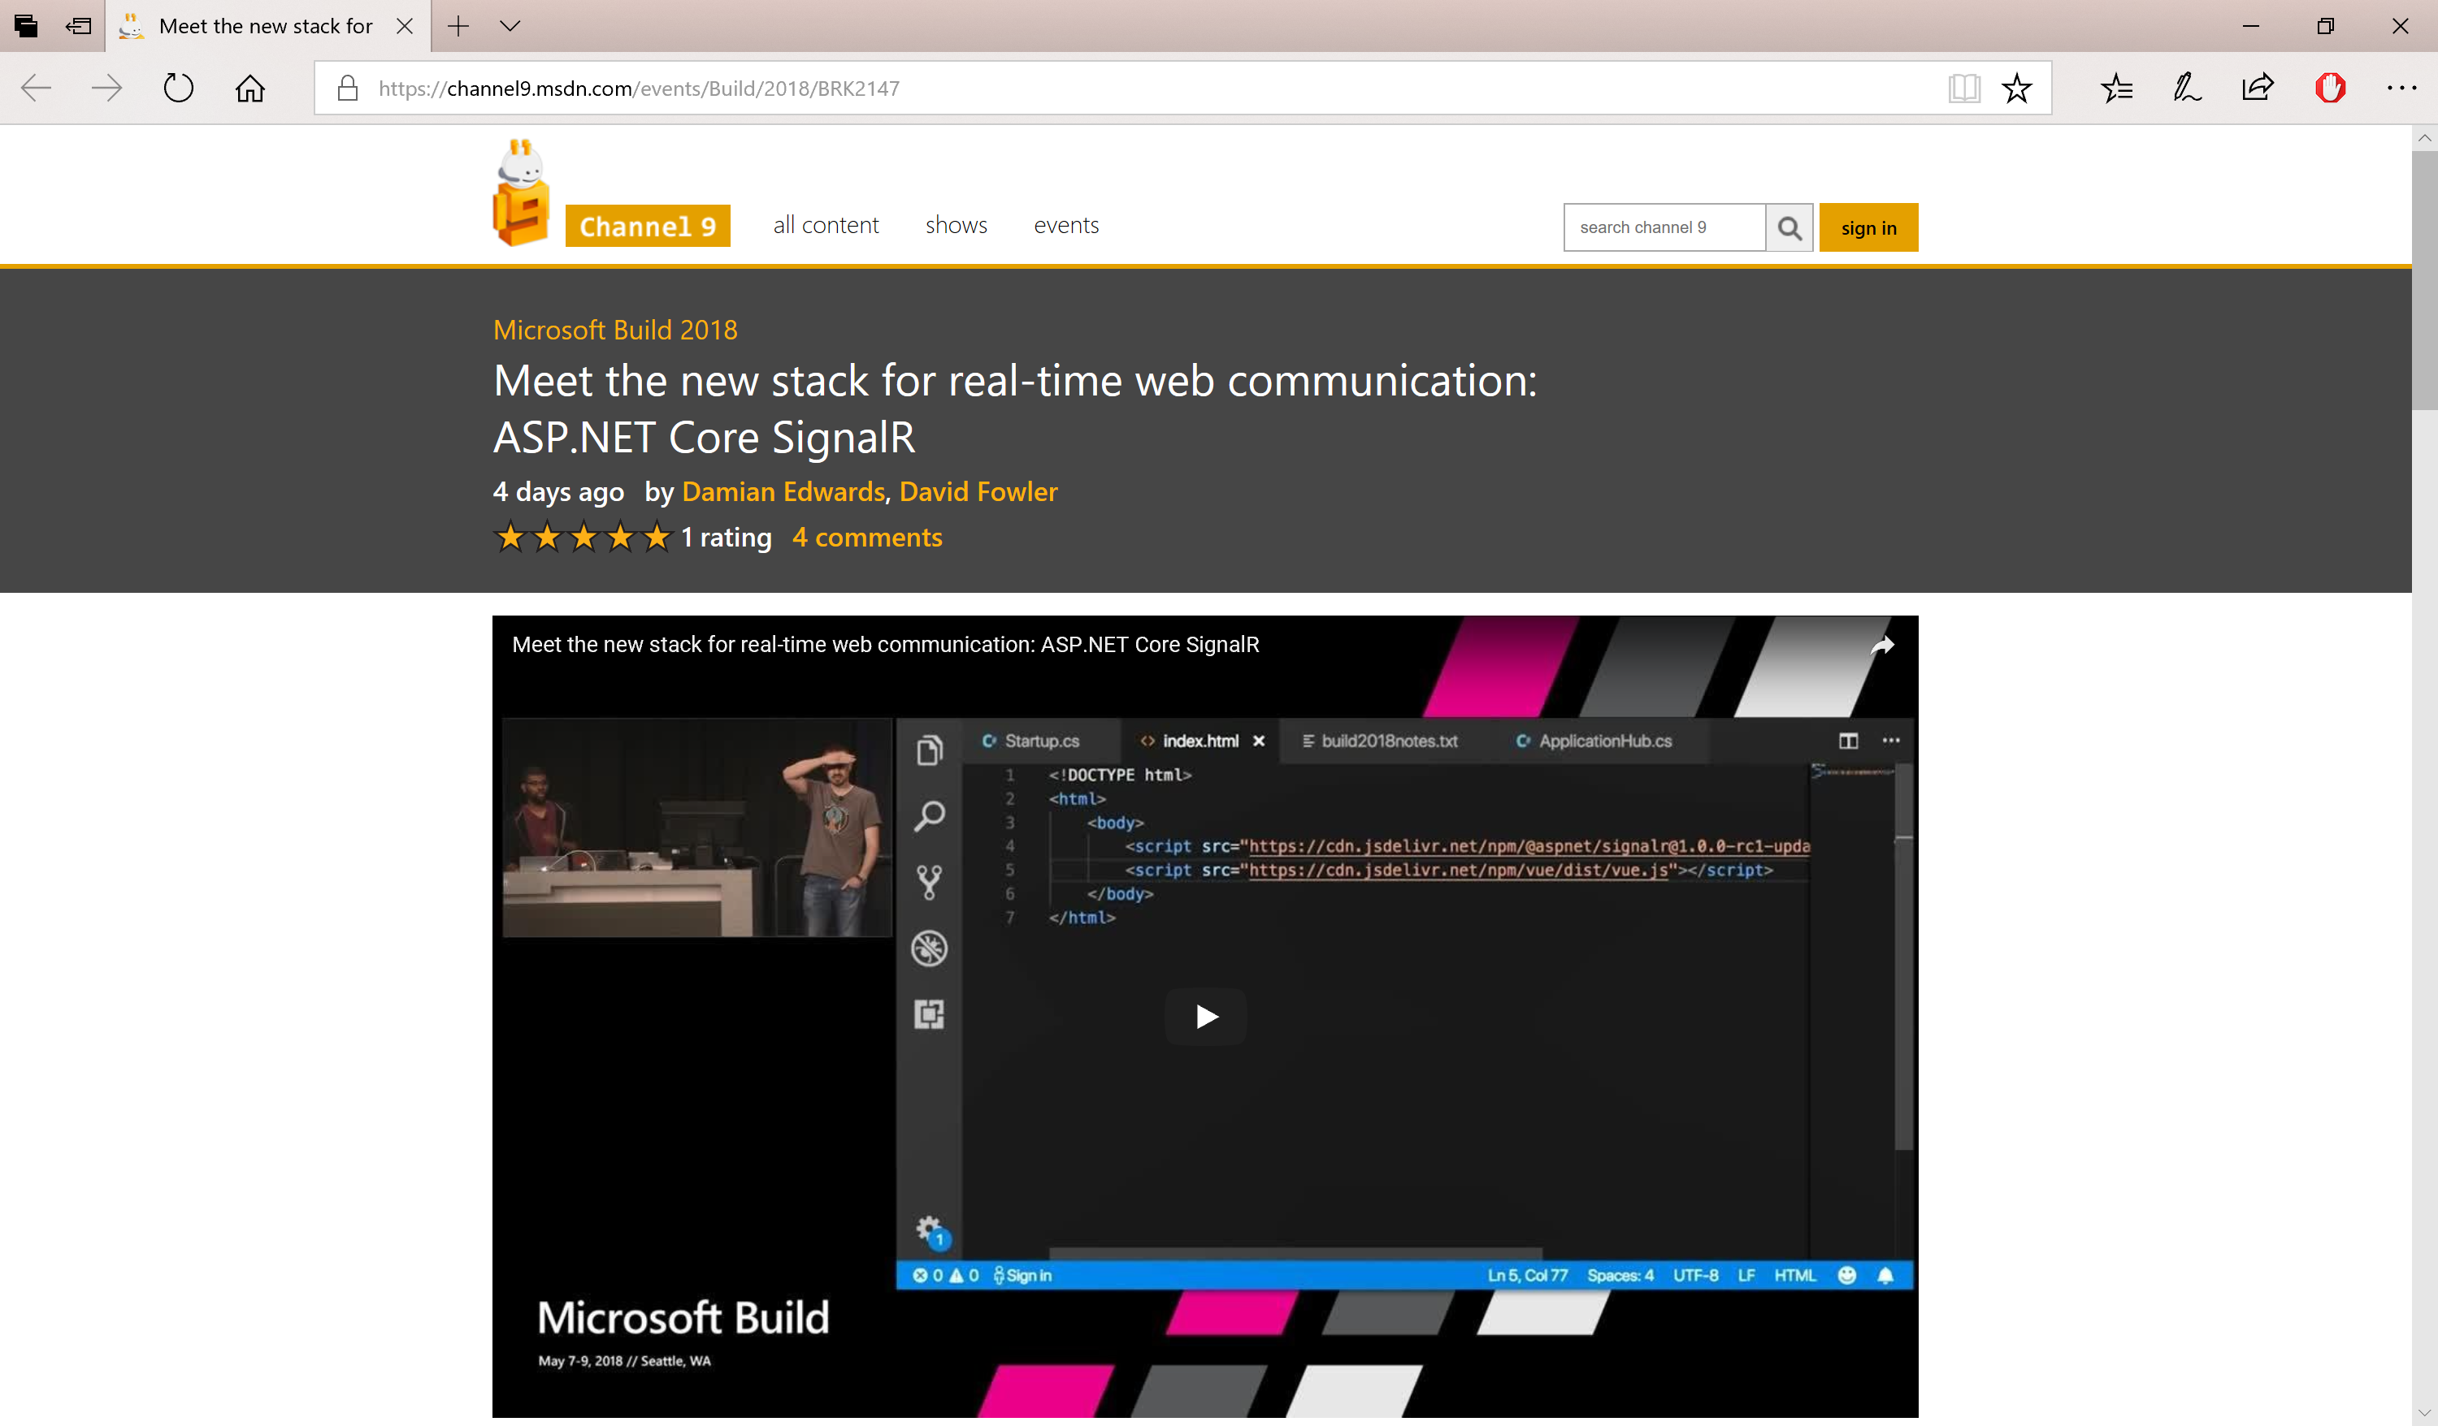
SignalR for ASP .NET Core 2.1
https://channel9.msdn.com/events/Build/2018/BRK2147

Slide 99

ASP .NET Core @ Build 2018
https://aka.ms/AspNetCore-Build2018

Slide 100

ASP .NET Core @ .NET Conf 2018
https://aka.ms/AspNetCore-DotNetConf2018

Slide 101

ASP .NET Core @ Ignite 2018
https://aka.ms/AspNetCore-Ignite2018

Slide 102

ASP .NET Core @ Connect(); 2018
https://aka.ms/AspNetCore-Connect2018

Slide 103

Jeff Fritz on Twitch/YouTube
https://www.youtube.com/watch?v=--lYHxrsLsc

Slide 104


Other Video Sources
.NET Conf: http://www.dotnetconf.net
MSDN Channel 9: https://channel9.msdn.com

Slide 105

Docs + Tutorials
Docs + Tutorials: https://docs.microsoft.com/en-us/aspnet/core

Slide 106

ASP.NET Core 2.0 Release
https://blogs.msdn.microsoft.com/webdev/2017/08/14/announcing-asp-net-core-2-0/

Slide 107

ASP.NET Core 2.1 Roadmap
https://blogs.msdn.microsoft.com/webdev/2018/02/02/asp-net-core-2-1-roadmap/

Slide 108

.NET Core Roadmap
https://github.com/dotnet/core/blob/master/roadmap.md

Slide 109

ASP.NET Core 2.1 RC
https://blogs.msdn.microsoft.com/webdev/2018/05/07/asp-net-core-2-1-0-rc1-now-available/

Slide 110

ASP.NET Core 2.1 Released
https://blogs.msdn.microsoft.com/dotnet/2018/05/30/announcing-net-core-2-1/

Slide 111

ASP.NET Core 2.2 Released
https://blogs.msdn.microsoft.com/webdev/2018/12/04/asp-net-core-2-2-available-today/

Slide 112


ASP.NET Core 3.0 Preview 1
https://blogs.msdn.microsoft.com/dotnet/2018/12/04/announcing-net-core-3-preview-1-and-open-sourcing-windows-desktop-frameworks/

Slide 113
MEAN Stack…?

Slide 114

NICE Stack!
.NET
IIS (optional)
C#
Entity Framework
nicestack.io

Slide 115
References
ASP .NET: http://www.asp.net
.NET Core: https://www.microsoft.com/net
.NET Web Dev Blog: https://blogs.msdn.microsoft.com/webdev
Scott Hanselman’s Blog: https://www.hanselman.com/blog
.NET Conf: http://www.dotnetconf.net
MSDN Channel 9: https://channel9.msdn.com
Tutorials: https://docs.microsoft.com/en-us/aspnet/core/tutorials/first-mvc-app
C# 7: https://docs.microsoft.com/en-us/dotnet/articles/csharp/csharp-7
ASP.NET Core Roadmap: https://github.com/aspnet/Home/wiki/Roadmap
.NET Core Roadmap: https://github.com/dotnet/core/blob/master/roadmap.md

Slide 116
Other Resources
New Razor Pages: http://www.hishambinateya.com/welcome-razor-pages
Intro to Razor: https://docs.microsoft.com/en-us/aspnet/core/mvc/razor-pages
Live Unit Testing: https://blogs.msdn.microsoft.com/visualstudio/2016/11/18/live-unit-testing-visual-studio-2017-rc
Migrating from MVC to MVC Core: https://docs.microsoft.com/en-us/aspnet/core/migration/mvc
Visual Studio Code: https://code.visualstudio.com
dotnet/cli on GitHub: https://github.com/dotnet/cli

Slide 117
Q & A
Notes:
Additional Topics

Slide 118
Agenda
Introduction
> .NET (Framework & Core)
> ASP.NET Core
> Visual Studio & VS Code
References + Wrap-up
Notes:
Agenda

Slide 119

Email: shchowd@microsoft.com  Twitter: @shahedC
Notes:
Contact
Microsoft email: shchowd@microsoft.com
Personal Twitter: @shahedC
Dev Blog: WakeUpAndCode.com

